Slide 1
Debugging and Tracing
11/02/2015
Namhoon Kim

Slide 2
Building the kernel
cd litmus-rt; git checkout github/master -b demo
  This will check out master branch from github and create a demo branch.
cp ../configs/v4.1.3/litmus-kvm-x86_64-debug .config
  The base version of current LITMUS is 4.1.3, so we use the default configuration for v4.1.3.
make menuconfig
  Change kernel options.
make -j 4 # use 4 cpus
  Compile the kernel source.
After the kernel successfully compiled, you should have the kernel image (arch/x86/boot/bzImage)

Slide 3
Kernel configurations
In General setup.
  Change Local version strings.
  Disable “Control Group support”.
In processor type and features.
  Choose “Preemptible Kernel” for Preemption Model.
In Power management and ACPI options.
  Disable power management options like frequency scaling.
In Kernel hacking.
  Disable “Write protect kernel read-only data structures”.

Slide 4
Compiling API
liblitmus
  cd ~/demo/liblitmus
  make
    Compile user-space library for interacting LITMUS kernel.
feather-trace-tools
  cd ~/demo/feather-trace-tools
  make

Slide 5
Running LITMUS
cd ~/demo
./run_kvm-x86_64_nograp_sshbind.sh litmus-rt/arch/x86/boot/bzImage 4
  Change the redirection port number and the disk image parameter (-hda option) before you run the script.
Copy feather-trace-tools to VM if needed.
@VM> scp -rp <yourlogin>@ludwig.cs.unc.edu:demo/liblitmus .

Slide 6
Running real-time tasks
/proc/litmus/ : LITMUS information.
  active_plugin: the currently activated plugin.
  plugins/loaded: all available plugins.
Switching plugin.
  # echo “GSN-EDF” > /proc/litmus/active_plugin
  # cat /proc/litmus/active_plugin
  GSN-EDF
  or
  # cd ~/liblitmus
  # ./setsched GSN-EDF
  # ./showsched
  GSN-EDF

Slide 7
Running real-time tasks
rtspin: run a real-time task.
  usage: rtspin [-w] <WCET(ms)> <PERIOD(ms)> <DURATION(s)>
  -w: queue up for a synchronous release.
release_ts: release real-time tasks.
# ./rtspin -w 10 50 5 &
# ./rtspin -w 10 60 5 &
# ./rtspin -w 10 70 5 &
# cat /proc/litmus/stats
…
# release_ts

Slide 8
Logging debug messages
/dev/litmus/log: trace buffers for litmus_log trace.
  Can be read by opening the file and reading.
  # cat /dev/litmus/log > log.txt &

Slide 9
Adding a new plugin
Plugins are implemented as kernel modules.
Global-FIFO scheduler.
  Similar to GSN-EDF.
  Tasks are scheduled in the order that they arrive.

Slide 10
Adding a new plugin
Global-FIFO plugin.
  include/litmus/fifo_common.h : header file.
  litmus/fifo_common.c : common fuctions.
  litmus/sched_gsn_fifo.c : gsn-fifo plugin.
Update Makefile.
  Add fifo_common.o and sched_gsn_fifo.o.
Compile and run.

Slide 11
Adding a new plugin
We will reuse GSN-EDF plugin source codes.
Make copy of edf_common.h to fifo_common.h
  Rename edf* to fifo*
Make copy of edf_common.c to fifo_common.c
  Rename edf* to fifo*
  Include <litmus/fifo_common.h> instead of <litmus/edf_common.h>
  In fifo_higher_prio(),
    earlier_deadline() -> earlier_release()
    get_deadline() -> get_release()

Slide 12
Adding a new plugin
Make copy of sched_gsn_edf.c to sched_gsn_fifo.c
  Rename edf* to fifo*
  Replace all edf_higher_prio() to fifo_higher_prio().
  Update all *edf* function calls to *fifo*
  Include <litmus/fifo_common.h> instead of <litmus/edf_common.h>
  Remove all #ifdef CONFIG_LITMUS_LOCKING block.
  Rename .plugin_name to “GSN-FIFO”.

Slide 13
Adding a new plugin
Compile the kernel
  make -j 4
    Make sure that you have fifo_common.o and sched_gsn_fifo.o in litmus directory.
Run the VM and check that your GSN-FIFO plugin is loaded.
  cat /proc/litmus/plugins/loaded

Slide 14
Debugging plugins using GDB
What is GDB?
  GDB (The GNU Debugger) is a popular debugging tool.
  http://www.gnu.org/software/gdb/
Allow the user to examine variables and state.

Slide 15
Compile with debug information
In kernel configuration, enable “Compile the kernel with debug info”.
Enabled by default (assuming that you use litmus-kvm-x86_64-debug)
@ludwig> cd ~/demo/litmus-rt
@ludwig> make menuconfig
Kernel Hacking → Compile the kernel with debug info

Slide 16
Enable GDB stub
Invoke qemu with -s and -S options
  -s provides a gdb stub. (shorthand for -gdb tcp::1234)
  -S freezes the CPU on startup.

Slide 17
Starting VM
Run qemu with -s and -S options.
@ludwig> cd ~/demo
@ludwig> qemu-system-x86_64 -smp 4 -cpu core2duo -hda debian_x86_64.qcow2 -m 2000 -net nic,model=e1000 -net user -k en-us -kernel litmus-rt/arch/x86/boot/bzImage -append "console=ttyS0 root=/dev/hda1" ro -nographic -serial stdio -redir tcp:2222::22 -s -S

Slide 18
Starting VM
Start GDB in another window.
# Load GDB for debugging this kernel
@ludwig> gdb ~/demo/litmus-rt/vmlinux
…
Reading symbols from /home/namhoonk/demo/litmus-rt/vmlinux...done.
# Connect to the local VM
(gdb) target remote localhost:1234
# Continue a paused VM
(gdb) c
# Pause the VM
(gdb) <ctrl-c>

Slide 19
Debugging plugins
Set breakpoints in gsnfifo_admit_task()
(gdb) b gsnfifo_admit_task
# Continue
(gdb) c

Slide 20
Debugging plugins
Stack traces
# Print backtrace of all stack frames
(gdb) bt
# Print all stack frames with the local variables
(gdb) bt full
# Select the 2nd frame
(gdb) f 2
# Select and print stack frame that called this one
(gdb) up
# Select and print stack frame called by this one.
(gdb) down
# Print value of the variable name
(gdb) p <variable-name>

Slide 21
Tracing and logging
3 tracing mechanisms
  Debug traces.
    /dev/litmus/log
  Scheduling traces.
    /dev/litmus/sched_traceX
  Overhead traces.
    /dev/litmus/ft_cpu_traceX
    /dev/litmus/ft_msg_traceX

Slide 22
Debug Traces
TRACE() macro.
  Print messages (like printk).
  It can be used in any context.
Recording debug traces.
Kill the cat process to stop recording.
@VM> cat /dev/litmus/log > log.txt &

Slide 23
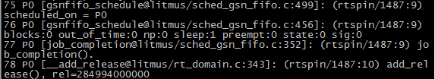
Debug Traces
<seq#> <cpu> <[function@file:line]:> <trace_message>

Slide 24
Scheduling traces
Scheduling traces are recorded using feather-trace-tools.
The definition and an explanation of the format can be found in the file <include/litmus/sched_trace.h>

Slide 25
Scheduling traces
Log binary-encoded scheduling event information.
Copy feather-trace-tools to VM if needed.
@VM> scp -rp <yourlogin>@ludwig.cs.unc.edu:demo/feather-trace-tools .

Slide 26
Scheduling traces
Recording scheduling traces.
  The tag is used to assign a unique name to the trace files.
Run rtspin in another window.
@VM> cd ~/feather-trace-tools
@VM> ./st_trace <tag_name>
@VM> cd ~/liblitmus
@VM> ./setsched GSN-EDF
@VM> ./rtspin -w 50 500 5 &
@VM> ./rtspin -w 20 200 5 &
@VM> ./rtspin -w 10 100 5 &
@VM> ./rtspin -w 5 50 5 &
@VM> ./release_ts

Slide 27
Scheduling traces
Recorded traces can be analyzed with Unit-Trace (http://cs.unc.edu/~mollison/unit-trace/).
Installing Unit-Trace
# Download Unit-Trace
@ludwig> cd ~/demo
@ludwig> wget http://cs.unc.edu/~mollison/unit-trace/unit-trace.tar.gz
# Decompress
@ludwig> tar zxvf unit-trace.tar.gz

Slide 28
Scheduling traces
Unit-Trace use
# Copy .bin files (recorded data) out of the VM.
@VM>scp st*.bin <your_login>@ludwig.cs.unc.edu:~/demo/unit-trace
# Run unit-trace
# -v: visualize
# -c: don’t show data before synchronous release
# You need the X Window System
@ludwig>./unit-trace -vc *.bin

Slide 29
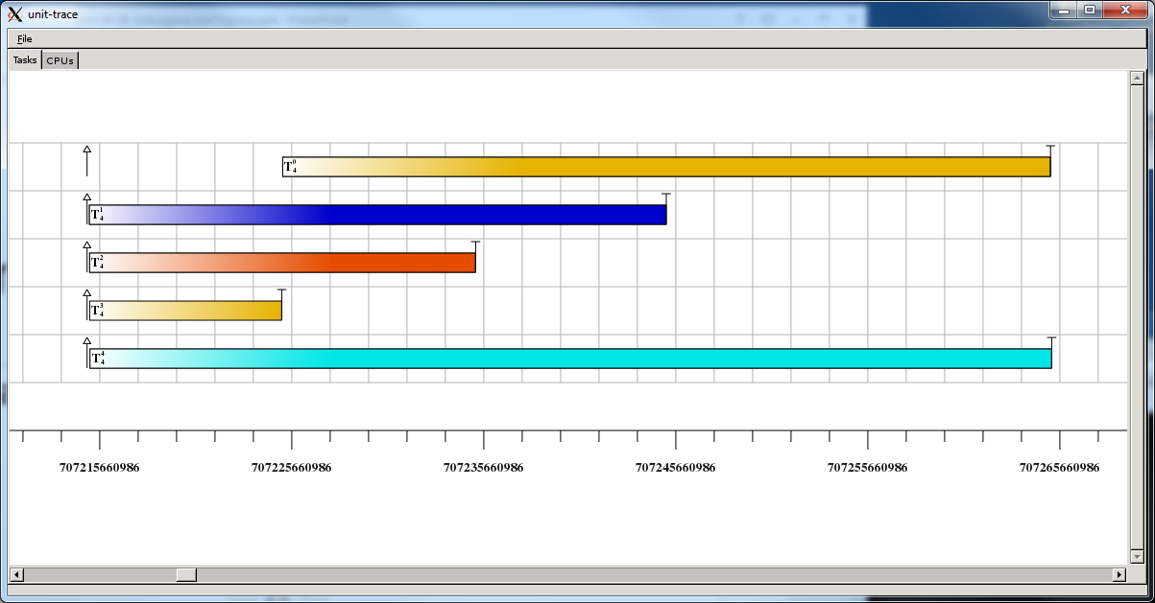
Unit-trace

Slide 30
To-Do
Add GSN-FIFO plugin.
  http://www.cs.unc.edu/~anderson/real-time/lunch/2010-09-13-LitmusGFIFOTutorial.docx
Run real-time tasks under GSN-FIFO and GSN-EDF (use debug traces and scheduling traces).
Check the differences between FIFO and EDF scheduling with tracing tools.

Slide 31
Appendix
GDB User manual
  https://sourceware.org/gdb/current/onlinedocs/gdb/
LITMUS Tracing Tutorial
  https://wiki.litmus-rt.org/litmus/Tracing
Unit-Trace
  http://cs.unc.edu/~mollison/unit-trace/

