Slide 1
Introduction to LITMUS^{RT}
10/26/2015
Namhoon Kim

Slide 2
LITMUS^{RT}
LITMUS^{RT} is a patch to the Linux kernel.
  http://www.litmus-rt.org/
  The current version of LITMUS^{RT} is 2015.1 and is based on Linux 4.1.3.
Support for developing real-time tasks, schedulers, and synchronization protocols.

Slide 3
Components
litmus-rt: LITMUS^{RT} kernel.
liblitmus: user-space library for interacting with LITMUS^{RT}.
configs: kernel configurations.
feather-trace-tools: event tracing toolkit.

Slide 4
Getting the code
LITMUS code are managed with Git.
Two repositories.
  public repository (https://github.com/LITMUS-RT)
  our private repository (rtsrv.cs.unc.edu)
Git urls.
  https://github.com/LITMUS-RT/litmus-rt.git
  ssh://rtsrv.cs.unc.edu/home/litmus/litmus-rt.git

Slide 5
What is LITMUS^{RT} patch?
Litmus adds a scheduling class (SCHED_LITMUS).
  When a task is in SCHED_LITMUS, Linux delegates its scheduling decision to Litmus code.
How can we implement a new scheduler?
  To do this, we have to take care of kernel stacks, task migrations, context switches, and so on.
The SCHED_LITMUS class takes care of all these.

Slide 6
Linux scheduler
The Linux scheduler is wrapped in a scheduling class.
The sched_class data structure can be found in include/linux/sched.h.
All existing scheduling classes in the kernel are in a list which is ordered by the priority of the scheduling class.
  litmus_sched_class → stop_sched_class → dl_sched_class → rt_sched_class → fair_sched_class → idle_sched_class → NULL
Litmus preempts everything and can be preempted by nothing.

Slide 7
Litmus plugins
Currently supports GSN-EDF, PSN-EDF, C-EDF, Pfair, and P-FP.
Only one plugin can be activated at a time.
  SCHED_LITMUS does nothing.
  Litmus plugins make scheduling decisions.

Slide 8
Litmus source code
Linux kernel sources
    arch
    drivers
    fs
    kernel
    include
    init
    ipc
    lib
    mm
    modules
    net
    scripts
Litmus kernel sources
    arch
    drivers
    fs
    kernel
    include – include/litmus
    init
    ipc
    lib
    litmus
    mm
    modules
    net
    scripts

Slide 9
Real-time tasks in Litmus
To support real-time task models, we use struct rt_param (in include/litmus/rt_param.h).
  rt_task: task parameters (exec_cost, period, relative_deadline…).
  rt_job: job parameters (job_no, release, deadline, exec_time, and lateness).
The notion of time in Litmus
  lt_t type: unsigned long long (nanoseconds).

Slide 10
Useful kernel macros
Per-CPU variables.
  DEFINE_PER_CPU
  When you create a per-CPU variable, each processor on the system gets its own copy of that variable.
  http://www.makelinux.net/ldd3/chp-8-sect-5
Linked lists.
  struct list_head
  A standard implementation of doubly linked lists.
  No locking protocols.
  Several functions are defined in <linux/list.h>
  http://www.makelinux.net/ldd3/chp-11-sect-5

Slide 11
LITMUS source code
include/litmus/litmus.h
  Macros for getting task or job parameters.
litmus : LITMUS plugin source code.
  litmus/rt_domain.c : support for sporadic tasks. rt_domain structure is used in every plugin.
  litmus/sched_*.c : litmus scheduling plugins.

Slide 12
rt_domain
See include/litmus/rt_domain.h.
Primary components:
  ready_queue: a binary heap of ready tasks
  release_queue: a queue of heaps, where each heap is a group of tasks with the same release.
  timer: a timer which triggers the next release.
  release_jobs: function to call on job release.
  order: function to sort tasks by priority in queue.

Slide 13
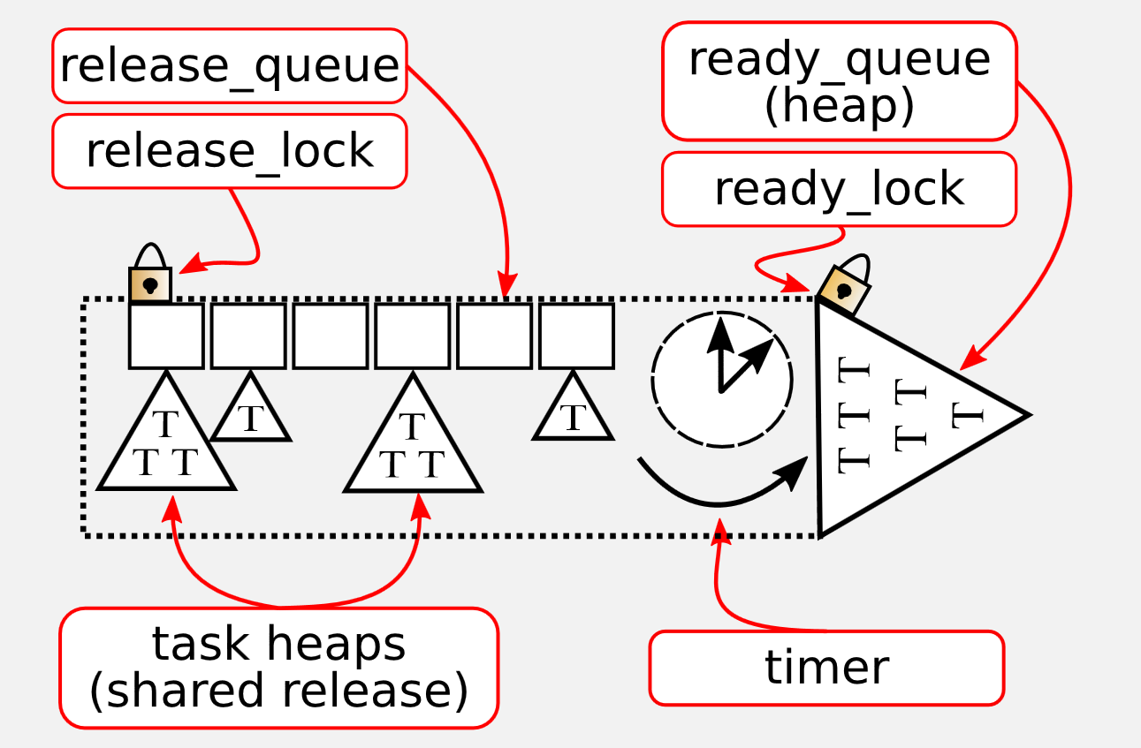
rt_domain
A figure from the previous litmus lunch

Slide 14
Scheduling plugins
A set of event handlers are defined to be called by SCHED_LITMUS.
static struct sched_plugin gsn_edf_plugin __cacheline_aligned_in_smp = {
.plugin_name = "GSN-EDF",
.finish_switch = gsnedf_finish_switch,
.tick = gsnedf_tick,
.task_new = gsnedf_task_new,
.complete_job = complete_job,
.task_exit = gsnedf_task_exit,
.schedule = gsnedf_schedule,
.task_wake_up = gsnedf_task_wake_up,
.task_block = gsnedf_task_block,
.admit_task = gsnedf_admit_task,
.activate_plugin = gsnedf_activate_plugin,
.allocate_lock = gsnedf_allocate_lock,
};

Slide 15
Event handlers
activate_plugin/deactivate_plugin: called when the user enables/disables the plugin.
admit_task: determine if the plugin can admit this task. It is used to verify parameters.
task_new/task_exit: called when an admitted task enters/exits SCHED_LITMUS.

Slide 16
Scheduling event handlers
schedule: called whenever CPU needs to schedule tasks.
task_block/task_wake_up: called when a task blocks/resumes.

Slide 17
Event handlers
schedule
new
exit
admit
A
B
A
time
block
wake_up

Slide 18
Litmus API
Git repository
  https://github.com/LITMUS-RT/liblitmus.git
User-space library for LITMUS^{RT}.
Programs
  setsched / showsched : set/show the active plugin. Need a root privilege.
  rtspin : a simple loop program.
  release_ts : Release the task system. Used for synchronous task releases.
  base_task : Example single-threaded real-time task.
  base_mt_task : Example multi-threaded real-time task.

Slide 19
TODO
Join our LITMUS^{RT} mailing list.
  litmus-rt@listserv.unc.edu
  http://help.unc.edu/help/subscribing-to-a-list/
Send me your preferred user name for servers.
  namhoonk@cs.unc.edu
Get the copies of Litmus code.
Read git basics.
  https://git-scm.com/book/en/v2/Getting-Started-Git-Basics
Read kvm (qemu) basics (about running a guest OS).

