Slide 1
Debugging and Tracing
Namhoon Kim

Slide 2
Debugging plugins using GDB
What is GDB?
  GDB (The GNU Debugger) is a popular debugging tool.
  http://www.gnu.org/software/gdb/
Allow the user to examine variables and state.

Slide 3
Compile with debug information
In kernel configuration, enable “Compile the kernel with debug info”.
Enabled by default (assuming that you use litmus-kvm-x86_64-gelliott-debug)
@ludwig> cd ~/demo/litmus-rt
@ludwig> make menuconfig
Kernel Hacking → Compile the kernel with debug info

Slide 4
Enable GDB stub
Invoke qemu with -s and -S options
  -s provides a gdb stub. (shorthand for -gdb tcp::1234)
  -S freezes the CPU on startup.

Slide 5
Starting VM
Run qemu with -s and -S options.
@ludwig> cd ~/demo
@ludwig> qemu-system-x86_64 -smp 4 -cpu core2duo -hda debian_x86_64.qcow2 -m 2000 -net nic,model=e1000 -net user -k en-us -kernel litmus-rt/arch/x86/boot/bzImage -append "console=ttyS0 root=/dev/hda1" ro -nographic -serial stdio -redir tcp:2222::22 -s -S

Slide 6
Starting VM
Start GDB in another window.
# Load GDB for debugging this kernel
@ludwig> gdb ~/demo/litmus-rt/vmlinux
…
Reading symbols from /home/namhoonk/demo/litmus-rt/vmlinux...done.
# Connect to the local VM
(gdb) target remote localhost:1234
# Continue a paused VM
(gdb) c
# Pause the VM
(gdb) <ctrl-c>

Slide 7
Debugging plugins
Set breakpoints in gsnfifo_admit_task()
(gdb) b gsnfifo_admit_task
# Continue
(gdb) c

Slide 8
Debugging plugins
Stack traces
# Print backtrace of all stack frames
(gdb) bt
# Print all stack frames with the local variables
(gdb) bt full
# Select the 2nd frame
(gdb) f 2
# Select and print stack frame that called this one
(gdb) up
# Select and print stack frame called by this one.
(gdb) down
# Print value of the variable name
(gdb) p <variable-name>

Slide 9
Tracing and logging
3 tracing mechanisms
  /dev/litmus/log
    Debug Traces
  /dev/litmus/sched_traceX
    Scheduling Traces
  /dev/litmus/ft_trace0
    Overhead Traces

Slide 10
Debug Traces
TRACE() macro.
  Print messages (like printk).
  It can be used in any context.
Recording debug traces.
Kill the cat process to stop recording.
@VM> cat /dev/litmus/log > log.txt &

Slide 11
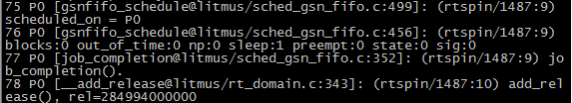
Debug Traces
<seq#> <cpu> <[function@file:line]:> <trace_message>

Slide 12
Scheduling traces
Scheduling traces are recorded using feather-trace-tools.
The definition and an explanation of the format can be found in the file <include/litmus/sched_trace.h>

Slide 13
Scheduling traces
Log binary-encoded scheduling event information.
Copy feather-trace-tools to VM.
@VM> scp -rp <yourlogin>@ludwig.cs.unc.edu:demo/feather-trace-tools .

Slide 14
Scheduling traces
Recording scheduling traces.
  The tag is used to assign a unique name to the trace files.
Run rtspin in another window.
@VM> cd ~/feather-trace-tools
@VM> ./st_trace <tag_name>
@VM> cd ~/liblitmus
@VM> ./setsched GSN-EDF
@VM> ./rtspin -w 50 500 10 &
@VM> ./rtspin -w 20 200 10 &
@VM> ./rtspin -w 10 100 10 &
@VM> ./rtspin -w 5 50 10 &
@VM> ./release_ts

Slide 15
Scheduling traces
Recorded traces can be analyzed with Unit-Trace (http://cs.unc.edu/~mollison/unit-trace/).
Installing Unit-Trace
# Download Unit-Trace
@ludwig> cd ~/demo
@ludwig> wget http://cs.unc.edu/~mollison/unit-trace/unit-trace.tar.gz
# Decompress
@ludwig> tar zxvf unit-trace.tar.gz

Slide 16
Scheduling traces
Unit-Trace use
# Copy .bin files (recorded data) out of the VM.
@VM>scp st*.bin <your_login>@ludwig.cs.unc.edu:~/demo/unit-trace
# Run unit-trace
# -v: visualize
# -c: don’t show data before synchronous release
# You need the X Window System
@ludwig>./unit-trace -vc *.bin

Slide 17
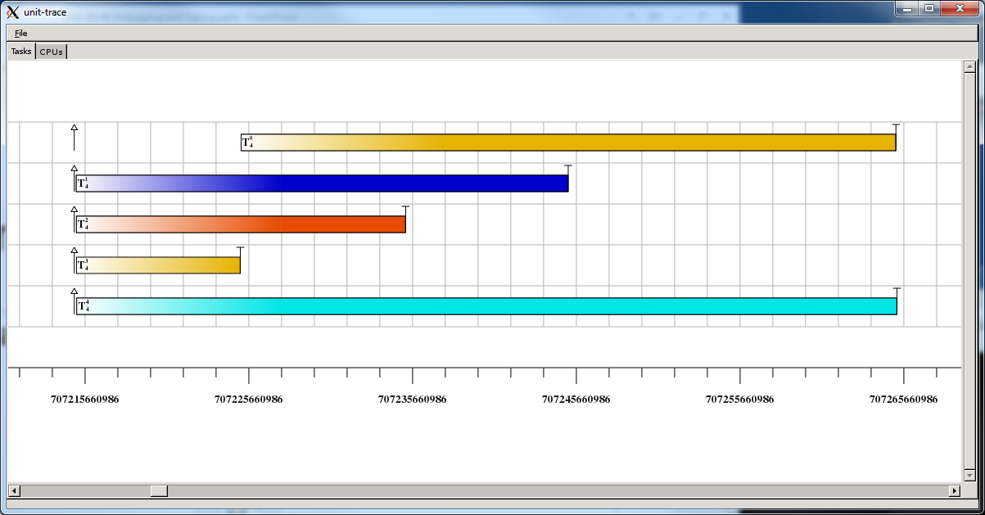
Unit-trace

Slide 18
To-Do
Add GSN-FIFO plugin.
  http://www.cs.unc.edu/~anderson/real-time/lunch/2010-09-13-LitmusGFIFOTutorial.docx
Run real-time tasks under GSN-FIFO and GSN-EDF. (use debug traces and scheduling traces)
Check the differences between FIFO and EDF scheduling.

Slide 19
Appendix
GDB User manual
  https://sourceware.org/gdb/current/onlinedocs/gdb/
LITMUS Tracing Tutorial
  https://wiki.litmus-rt.org/litmus/Tracing
Unit-Trace
  http://cs.unc.edu/~mollison/unit-trace/

