Slide 1
Introduction to LITMUS^{RT}
8/25/2014
Namhoon Kim

Slide 2
LITMUS^{RT} basics
LITMUS^{RT} is a patch to the Linux kernel.
Support for developing real-time tasks, schedulers, and protocols.

Slide 3
Components
litmus-rt: LITMUS kernel.
liblitmus: user-space library for interacting with LITMUS.
configs: kernel configurations.
feather-trace-tools: event tracing toolkit.

Slide 4
Get the code
LITMUS code are managed with Git.
Two repositories
  public repo (https://github.com/LITMUS-RT)
  our private repo (rtsrv)
You are tracking both (assuming you followed earlier instructions)
  github
  origin (rtsrv)

Slide 5
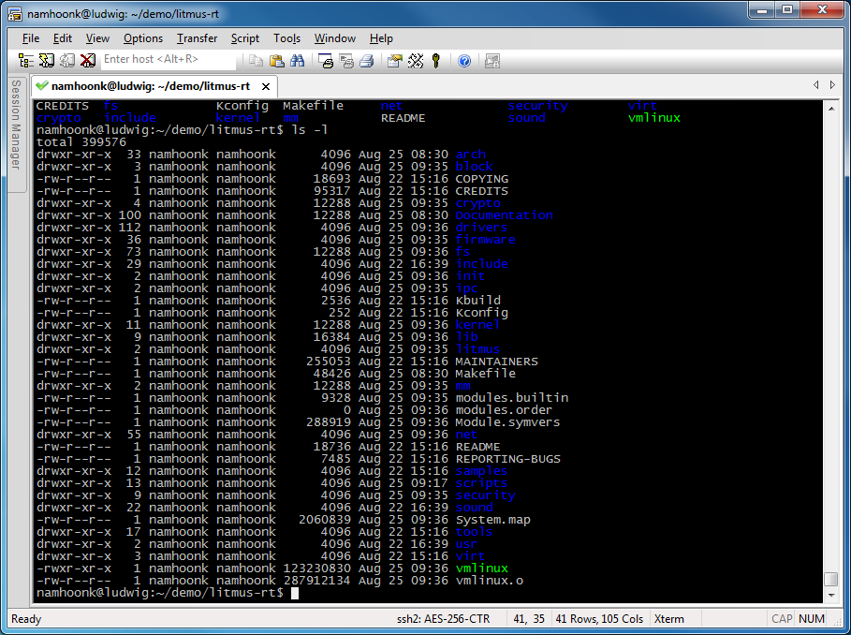
LITMUS code
include/litmus : LITMUS header files.
litmus : LITMUS plugin source code.

Slide 6
LITMUS scheduler
SCHED_LITMUS : a scheduling class added by LITMUS to Linux. It has the highest priority in the system.
If the scheduling class for a process is SCHED_LITMUS, the current activated LITMUS plugin makes scheduling decisions.

Slide 7
LITMUS plugins
A set of event handlers are defined to be called by SCHED_LITMUS.
static struct sched_plugin gsn_edf_plugin __cacheline_aligned_in_smp = {
.plugin_name = "GSN-EDF",
.finish_switch = gsnedf_finish_switch,
.tick = gsnedf_tick,
.task_new = gsnedf_task_new,
.complete_job = complete_job,
.task_exit = gsnedf_task_exit,
.schedule = gsnedf_schedule,
.task_wake_up = gsnedf_task_wake_up,
.task_block = gsnedf_task_block,
.admit_task = gsnedf_admit_task,
.activate_plugin = gsnedf_activate_plugin,
.allocate_lock = gsnedf_allocate_lock,
};

Slide 8
Event handlers
admit_task: determine if the plugin can admit this task.
task_new/task_exit: called when an admitted task enters/exits SCHED_LITMUS
schedule: called whenever CPU needs to schedule tasks.
task_block/task_wake_up: called when a task blocks/resumes

Slide 9
Event handlers
new
schedule
admit
exit
A
A
time
block
wake_up

Slide 10
Building the kernel
cd litmus-rt; git checkout origin/master -b demo
  This will check out master branch from rtsrv and create a demo branch.
cp ../configs/v3.10/litmus-kvm-x86_64-gelliott-debug .config
  The base version of current LITMUS is 3.10, so we use the default configuration for v3.10.
make menuconfig
  Change kernel options.
make -j 4 # use 4 cpus
  Compile the kernel source.
After the kernel successfully compiled, you should have the kernel image (arch/x86/boot/bzImage)

Slide 11
Kernel configurations
In General setup
  Change Local version strings.
In processor type and features
  Choose 1000Hz for timer frequency.
  Choose Preemptible Kernel for Preemption Model.
In Power management and ACPI options
  disable power management options like frequency scaling.

Slide 12
Compiling API
liblitmus
  cd ~/demo/liblitmus
  make
    Compile user-space library for interacting LITMUS kernel.
feather-trace-tools
  cd ~/demo/feather-trace-tools
  make

Slide 13
Running LITMUS
cd ~/demo
./run_kvm-x86_64_nograp_sshbind.sh litmus-rt/arch/x86/boot/bzImage 4
  Change the redirection port number before you run the script.
Login the VM.
scp -rp <yourlogin>@ludwig.cs.unc.edu:demo/liblitmus .
  Liblitmus in the disk image is out of date, so we want to copy the newest liblitmus.

Slide 14
Running real-time tasks
/proc/litmus/ : LITMUS information.
  active_plugin: the currently activated plugin.
  plugins/loaded: all available plugins.
Switching plugin.
  # echo “GSN-EDF” > /proc/litmus/active_plugin
  # cat /proc/litmus/active_plugin
  GSN-EDF
  or
  # ./setsched GSN-EDF
  # ./showsched
  GSN-EDF

Slide 15
Running real-time tasks
rtspin: run a real-time task.
  usage: rtspin [-w] <WCET(ms)> <PERIOD(ms)> <DURATION(s)>
  -w: queue up for a synchronous release.
release_ts: release real-time tasks.
# ./rtspin -w 10 50 5 &
# ./rtspin -w 10 50 5 &
# ./rtspin -w 10 50 5 &
# cat /proc/litmus/stats
…
# release_ts

Slide 16
Logging debug messages
/dev/litmus/log: trace buffers for litmus_log trace.
  Can be read by opening the file and reading.
  # cat /dev/litmus/log > log.txt &

Slide 17
Adding a new plugin
Plugins are implemented as kernel modules.
Global-FIFO scheduler
  Similar to GSN-EDF.
  Tasks are scheduled in the order that they arrive.

Slide 18
Adding a new plugin
Global-FIFO plugin
  include/litmus/fifo_common.h : header file.
  litmus/fifo_common.c : common fuctions.
  litmus/sched_gsn_fifo.c : gsn-fifo plugin.
Update Makefile
  Add fifo_common.o and sched_gsn_fifo.o.
Compile and run.

Slide 19
Adding a new plugin
We will reuse GSN-EDF plugin source codes
Make copy of edf_common.h to fifo_common.h
  Rename edf* to fifo*
Make copy of edf_common.c to fifo_common.c
  Rename edf* to fifo*
  Include <litmus/fifo_common.h> instead of <litmus/edf_common.h>
  In fifo_higher_prio(),
    earlier_deadline() -> earlier_release()
    get_deadline() -> get_release()

Slide 20
Adding a new plugin
Make copy of sched_gsn_edf.c to sched_gsn_fifo.c
  Rename edf* to fifo*
  Replace all edf_higher_prio() to fifo_higher_prio().
  Update all *edf* function calls to *fifo*
  Include <litmus/fifo_common.h> instead of <litmus/edf_common.h>
  Remove all #ifdef CONFIG_LITMUS_LOCKING block.
  Rename .plugin_name to “GSN-FIFO”.

Slide 21
Adding a new plugin
Compile the kernel
  make -j 4
    Make sure that you have fifo_common.o and sched_gsn_fifo.o in litmus directory.
Run the VM and check that your GSN-FIFO plugin is loaded.
  cat /proc/litmus/plugins/loaded

