Slide 1
An Emerging Theory of Soft Real-Time on Multicore
Jim Anderson
University of North Carolina at Chapel Hill

Slide 2
A Brief History of Real-Time Computing
No deadline can ever be missed.
In a real-time system, tasks (programs) have deadline constraints (more on this later).
Most of this work focused on
uniprocessor systems. Many major
successes: rate-monotonic analysis,
the priority ceiling protocol, etc. etc.
Almost all of
this work has
focused on
hard real-time (HRT)
systems.
Why was this
important? After
all, we had
multiprocessors
before!
Many papers published on resource
allocation methods and analysis
techniques for real-time systems.
Research
focus
shifts to
multiprocs.
“Liu & Layland” published.
The formal study of
real-time systems begins.
The multicore
revolution begins.
1970
1980
1990
2000
2010

Slide 3
Is Multicore Ready for True HRT?
To ensure hard deadlines, bounds on worst-case task execution times are needed.
Timing analysis tools are used to obtain such bounds.
Adequate tools for multicore currently do not exist!
Core 1
…
Core m
L1
L1
L2

Slide 4
Is Multicore Ready for True HRT?
Why not?
Interactions across cores through shared hardware (caches, buses, etc.) are difficult to predict.
Can lead to execution-time predictions that are so conservative, the extra capacity of additional cores is negated!
Core 1
…
Core m
L1
L1
L2

Slide 5
Focus of this Talk
I will attempt to show that a rich theory exists now for the support of soft real-time (SRT) applications on multicore.
  Soft = some deadline misses are tolerable.
  SRT tasks can be provisioned less pessimistically.
And we should care why?...
  SRT constraints are common in practice.
  Even in many safety-critical systems!

Slide 6
Outline
Background.
  AKA “Real-Time 101.”
Tardiness bounds for global schedulers.
  Early bounds and several later improvements.
Scalability of global schedulers.
  Or, what happens when you really implement one…
Other issues.
  Enabling non-worst-case provisionings, dealing with I/O, precedence constraints, etc.
Future and ongoing work.

Slide 7
What is a Real-Time System?
A system with a dual notion of correctness:
  Logical correctness (“it does the right thing”);
  Temporal correctness (“it does it on time”).
A system wherein predictability is as important as performance.
A Simple Example: A robot arm picking up objects from a conveyor belt.

Slide 8
Sporadic Task Systems
(We’ll Limit Attention to Implicit Deadlines)
Consider a set τ of n sporadic tasks on m processors:
2
5
τ₁ = (2,5)
One Processor Here
…
τ₂ = (9,15)
job release
0
5
10
15
20
25
30
job deadline

Slide 9
Sporadic Task Systems
(We’ll Limit Attention to Implicit Deadlines)
Consider a set τ of n sporadic tasks on m processors:
  Each task τ_{i} = (C_{i},T_{i}) releases a job with worst-case execution cost (WCET) C_{i} at least T_{i} time units apart.
    τ_{i}’s utilization (or weight) is U_{i} = C_{i}/T_{i}.
    Total utilization is U(τ) = Σ_{τi} C_{i}/T_{i}.
2
5
τ₁ = (2,5)
One Processor Here
…
τ₂ = (9,15)
job release
0
5
10
15
20
25
30
job deadline

Slide 10
Sporadic Task Systems
(We’ll Limit Attention to Implicit Deadlines)
Consider a set τ of n sporadic tasks on m processors:
  Each task τ_{i} = (C_{i},T_{i}) releases a job with worst-case execution cost (WCET) C_{i} at least T_{i} time units apart.
    τ_{i}’s utilization (or weight) is U_{i} = C_{i}/T_{i}.
    Total utilization is U(τ) = Σ_{τi} C_{i}/T_{i}.
2
5
τ₁ = (2,5)
One Processor Here
…
τ₂ = (9,15)
job release
0
5
10
15
20
25
30
job deadline

Slide 11
Sporadic Task Systems
(We’ll Limit Attention to Implicit Deadlines)
Consider a set τ of n sporadic tasks on m processors:
  Each task τ_{i} = (C_{i},T_{i}) releases a job with worst-case execution cost (WCET) C_{i} at least T_{i} time units apart.
    τ_{i}’s utilization (or weight) is U_{i} = C_{i}/T_{i}.
    Total utilization is U(τ) = Σ_{τi} C_{i}/T_{i}.
2
5
τ₁ = (2,5)
2/5
One Processor Here
…
τ₂ = (9,15)
job release
0
5
10
15
20
25
30
job deadline

Slide 12
Sporadic Task Systems
(We’ll Limit Attention to Implicit Deadlines)
Consider a set τ of n sporadic tasks on m processors:
  Each task τ_{i} = (C_{i},T_{i}) releases a job with worst-case execution cost (WCET) C_{i} at least T_{i} time units apart.
    τ_{i}’s utilization (or weight) is U_{i} = C_{i}/T_{i}.
    Total utilization is U(τ) = Σ_{τi} C_{i}/T_{i}.
  Each job of τ_{i} has a relative deadline given by T_{i}.
2
5
τ₁ = (2,5)
One Processor Here
…
τ₂ = (9,15)
job release
0
5
10
15
20
25
30
job deadline

Slide 13
Sporadic Task Systems
(We’ll Limit Attention to Implicit Deadlines)
Consider a set τ of n sporadic tasks on m processors:
  Each task τ_{i} = (C_{i},T_{i}) releases a job with worst-case execution cost (WCET) C_{i} at least T_{i} time units apart.
    τ_{i}’s utilization (or weight) is U_{i} = C_{i}/T_{i}.
    Total utilization is U(τ) = Σ_{τi} C_{i}/T_{i}.
  Each job of τ_{i} has a relative deadline given by T_{i}.
2
5
τ₁ = (2,5)
One Processor Here
…
τ₂ = (9,15)
job release
0
5
10
15
20
25
30
job deadline

Slide 14
Sporadic Task Systems
(We’ll Limit Attention to Implicit Deadlines)
Remember this.
Consider a set τ of n sporadic tasks on m processors:
  Each task τ_{i} = (C_{i},T_{i}) releases a job with worst-case execution cost (WCET) C_{i} at least T_{i} time units apart.
    τ_{i}’s utilization (or weight) is U_{i} = C_{i}/T_{i}.
    Total utilization is U(τ) = Σ_{τi} C_{i}/T_{i}.
  Each job of τ_{i} has a relative deadline given by T_{i}.
This is an example of a earliest-deadline-first (EDF) schedule.
2
5
τ₁ = (2,5)
One Processor Here
…
τ₂ = (9,15)
job release
0
5
10
15
20
25
30
job deadline

Slide 15
Multiprocessor Real-Time Scheduling
Two Basic Approaches:
Partitioning
Global Scheduling
Steps:
Assign tasks to processors (bin packing).
Schedule tasks on each processor using uniprocessor algorithms.
Important Differences:
One task queue.
Tasks may migrate among the processors.

Slide 16
Hard vs. Soft Real-Time
HRT: No deadline is missed.
SRT: Deadline tardiness is bounded.
  This is the “UNC definition of SRT.”
    There are many others…
  Note: Tasks still must execute sequentially, i.e., a tardy job of task τ_{i} cannot execute in parallel with the next job of τ_{i}.
  A wide variety of global scheduling algorithms are capable of ensuring bounded tardiness with no utilization loss.
    Such algorithms are the focus of today’s talk…

Slide 17
Scheduling vs. Schedulability
What’s “Utilization Loss”?
W.r.t. scheduling, we actually care about two kinds of algorithms:
  Scheduling algorithm (of course).
    Example: Earliest-deadline-first (EDF): Jobs with earlier deadlines have higher priority.
  Schedulability test.
Utilization loss occurs when test requires
utilizations to be restricted to get a “yes” answer.
no timing requirement
will be violated if τ is
scheduled with EDF
yes
Test for
EDF
τ
a timing requirement
will (or may) be
violated …
no

Slide 18
Two Example Multiprocessor Schedulers
Partitioned EDF: P-EDF.
  Per-processor run queues, ordered by EDF.
Global EDF: G-EDF.
  A single system-wide run queue, ordered by EDF.

Slide 19
P-EDF
Util. Loss for Both HRT and SRT
Example: Partitioning three tasks with parameters
(2,3) on two processors will overload one processor.
In terms of bin-packing…
Under partitioning & most global algorithms, overall utilization must be capped to avoid deadline misses.
  Due to connections to bin-packing.
Exception: Global “Pfair” algorithms do not require caps.
  Such algorithms schedule jobs one quantum at a time.
    May therefore preempt and migrate jobs frequently.
    Perhaps less of a concern on a multicore platform.
Under most global algorithms, if utilization is not capped, deadline tardiness is bounded.
  Sufficient for soft real-time systems.
Task τ₁
1
Task τ₂
Task τ₃
0
Processor 1
Processor 2

Slide 20
G-EDF
HRT: Loss, SRT: No Loss
Under partitioning & most global algorithms, overall utilization must be capped to avoid deadline misses.
  Due to connections to bin-packing.
Exception: Global “Pfair” algorithms do not require caps.
  Such algorithms schedule jobs one quantum at a time.
    May therefore preempt and migrate jobs frequently.
    Perhaps less of a concern on a multicore platform.
Under most global algorithms, if utilization is not capped, deadline tardiness is bounded.
  Sufficient for soft real-time systems.
Previous example scheduled under G-EDF…
deadline miss
processor 1
processor 2
τ₁ = (2,3)
τ₂ = (2,3)
Note: “Bin-packing” here.
τ₃ = (2,3)
0
5
10
15
20
25
30

Slide 21
Outline
Background.
  AKA “Real-Time 101.”
Tardiness bounds for global schedulers.
  Early bounds and several later improvements.
Scalability of global schedulers.
  Or, what happens when you really implement one…
Other issues.
  Enabling non-worst-case provisionings, dealing with I/O, precedence constraints, etc.
Future and ongoing work.

Slide 22
Global Schedulers of Interest
All Prioritize Jobs by “Priority Points (PPs)” where Earlier Wins
Tardiness-bound results exist for these:
  Global EDF (G-EDF).
    PP = deadline.
    Tardiness first analyzed in [Devi & Anderson ‘05].
r
d
Release
Time
Deadline
Completion
PP
Notes:
To do that, we require the prioritization function ki to have values withing some finite interval including the release and
the deadine of the job. The picture illustrates how the priority of the job can vary with time.
All the algorithms that we described above, EDF, FIFO, LLF, EDZL, and NPEDF have this property.
If either condition is violated, then there exist a scheme with unbonded tardiness. For global RM the left inequality does not hold, because after sufficiently long time the release time of the job will be bigger than its number.

Slide 23
Global Schedulers of Interest
All Prioritize Jobs by “Priority Points (PPs)” where Earlier Wins
Tardiness-bound results exist for these:
  Global EDF (G-EDF).
    PP = deadline.
    Tardiness first analyzed in [Devi & Anderson ‘05].
  Window-Constrained schedulers [Leontyev & Anderson ‘07].
    PP remains within a window [r − ϕ, d + ψ] and may change with time.
r−φ
r
d
d+ψ
Release
Time
Deadline
Completion
PP
Notes:
To do that, we require the prioritization function ki to have values withing some finite interval including the release and
the deadine of the job. The picture illustrates how the priority of the job can vary with time.
All the algorithms that we described above, EDF, FIFO, LLF, EDZL, and NPEDF have this property.
If either condition is violated, then there exist a scheme with unbonded tardiness. For global RM the left inequality does not hold, because after sufficiently long time the release time of the job will be bigger than its number.

Slide 24
Global Schedulers of Interest
All Prioritize Jobs by “Priority Points (PPs)” where Earlier Wins
Tardiness-bound results exist for these:
  Global EDF (G-EDF).
    PP = deadline.
    Tardiness first analyzed in [Devi & Anderson ‘05].
  Window-Constrained schedulers [Leontyev & Anderson ‘07].
    PP remains within a window [r − ϕ, d + ψ] and may change with time.
  G-EDF-like (GEL) schedulers.
    PP is at a fixed time in [r, d].
  Global fair lateness (G-FL) [Erickson & Anderson ‘12].
    The “best” GEL algorithm.
r
d
Release
Time
Deadline
Completion
PP
Notes:
To do that, we require the prioritization function ki to have values withing some finite interval including the release and
the deadine of the job. The picture illustrates how the priority of the job can vary with time.
All the algorithms that we described above, EDF, FIFO, LLF, EDZL, and NPEDF have this property.
If either condition is violated, then there exist a scheme with unbonded tardiness. For global RM the left inequality does not hold, because after sufficiently long time the release time of the job will be bigger than its number.

Slide 25
Global Schedulers of Interest
All Prioritize Jobs by “Priority Points (PPs)” where Earlier Wins
Tardiness-bound results exist for these:
  Global EDF (G-EDF).
    PP = deadline.
    Tardiness first analyzed in [Devi & Anderson ‘05].
  Window-Constrained schedulers [Leontyev & Anderson ‘07].
    PP remains within a window [r − ϕ, d + ψ] and may change with time.
  G-EDF-like (GEL) schedulers.
    PP is at a fixed time in [r, d].
  Global fair lateness (G-FL) [Erickson & Anderson ‘12].
    The “best” GEL algorithm.
Window-Constrained Schedulers
GEL Schedulers
G-EDF
G-FL
r
d
Release
Time
Deadline
Completion
PP
Notes:
To do that, we require the prioritization function ki to have values withing some finite interval including the release and
the deadine of the job. The picture illustrates how the priority of the job can vary with time.
All the algorithms that we described above, EDF, FIFO, LLF, EDZL, and NPEDF have this property.
If either condition is violated, then there exist a scheme with unbonded tardiness. For global RM the left inequality does not hold, because after sufficiently long time the release time of the job will be bigger than its number.

Slide 26
GEL Schedulers
We’ll focus on GEL schedulers.
To summarize, under a GEL scheduler,
  each task τ_{i} has a relative priority point (PP) Y_{i}.
    A job of τ_{i} released at time r has an absolute PP at time r + Y_{i}.
    Early PPs have priority over later ones.
    Ex: Under G-EDF, Y_{i} = τ_{i}’s relative deadline.

Slide 27
Some Important Definitions
C_{i}: WCET
T_{i}: Period
U_{i}: Util.
Y_{i}: PP
A job of τ_{i} released at time r and that completes at time c has
  a response time of c − r,
  a lateness of c − (r + T_{i}), and
  tardiness equal to max(0, c − (r + T_{i})).
We assume:
  U_{i} ≤ 1,
  U(τ) ≤ m, and
  n > m.
Tardiness = Lateness
Response Time
T_{i}
τ_{i}
r
c
Time
Release
Deadline
Completion

Slide 28
Example Task System
= {(4,5),
(4,5),
(8,20)},
m = 2
C_{i}: WCET
T_{i}: Period
U_{i}: Util.
Y_{i}: PP
We’ll illustrate all analysis using this task system: τ = {(4,5), (4,5), (8,20)}, m = 2.
Here is a G-EDF schedule for τ:
CPU 1
τ₁
CPU 2
τ₂
τ₃
0
5
10
15
20
25
Time

Slide 29
Tardiness Under G-EDF Partially Explained
= {(4,5),
(4,5),
(8,20)},
m = 2
C_{i}: WCET
T_{i}: Period
U_{i}: Util.
Y_{i}: PP
Theorem: If U(τ) ≤ m, then each τ_{i} has
bounded tardiness under G-EDF.
Why (intuitively) would this theorem hold?
So the key is to determine how
far earlier-released jobs can
“push” J’s completion into the future.
If we inductively apply a
tardiness bound to these
earlier jobs, then we limit
the extent by which J can
be “pushed,” yielding a
tardiness bound for J.
So, J’s “fate” beyond
its deadline d is
entirely determined by
higher-priority jobs
released earlier.
Consider some job J of a task τ_{i} …
No jobs with higher priority
than J can be released.
J
T_{i}
τ_{i}
r
d
c
Time
Release
Deadline
Completion
(Assume J is scheduled alongside other jobs, which are not shown.)

Slide 30
In Contrast, Consider…
= {(4,5),
(4,5),
(8,20)},
m = 2
C_{i}: WCET
T_{i}: Period
U_{i}: Util.
Y_{i}: PP
Theorem: Even if U(τ) ≤ m, tardiness may be
unbounded under global static-priority
scheduling.
Why (intuitively) is this true?
Now jobs with higher priority
than J can be released here.
This part of the
earlier argument
breaks.
J
T_{i}
τ_{i}
r
d
c
Time
Release
Deadline
Completion
(Assume J is scheduled alongside other jobs, which are not shown.)

Slide 31
Original G-EDF Tardiness
Analysis
= {(4,5),
(4,5),
(8,20)},
m = 2
C_{i}: WCET
T_{i}: Period
U_{i}: Util.
Y_{i}: PP
Let C_{min} = min(C_{i}).
As shown in [Devi & Anderson ‘05], tardiness for task τ_{i} under G-EDF is at most C_{i} + x, where
Ex: In our running example, C_{min} = C₁ = 4,so x = (C₃ − C₁)/m = (8 − 4)/2 = 2.
  Thus, τ₁ and τ₂ have a tardiness bound of 2 + 4 = 6, and τ₃ has a tardiness bound of 2 + 8 = 10.

Slide 32
Compliant Vector Analysis
(CVA) [Erickson et al.,’10]
= {(4,5),
(4,5),
(8,20)},
m = 2
C_{i}: WCET
T_{i}: Period
U_{i}: Util.
Y_{i}: PP
Several new twists:
  Instead of a single x, we have an x_{i} per each task τ_{i}.
  The prior analysis is generalized to an arbitrary GEL algorithm.
    Before, we essentially computed a response time of T_{i} + x + C_{i} and a tardiness bound of T_{i} + x + C_{i} − T_{i} = x + C_{i}.
    Now, we’ll be computing a response time of Y_{i} + x_{i} + C_{i} and a lateness bound of Y_{i} + x_{i} + C_{i} − T_{i}.
Define x as the vector ⟨x₁, x₂, …, x_{n}⟩.
  x can be algorithmically (and efficiently) computed.
    This is what CVA is all about! We’ll skip the details…
T_{i}
≤ x + C_{i}
Y_{i}
≤ x_{i} + C_{i}
τ_{i}
r
c
Time
τ_{i}
r
c
Time

Slide 33
Example, Revisited
= {(4,5),
(4,5),
(8,20)},
m = 2
C_{i}: WCET
T_{i}: Period
U_{i}: Util.
Y_{i}: PP
Before, we computed tardiness bounds of 6 for τ₁ and τ₂ and 10 for τ₃.
Under CVA, we would get 6 for τ₁ and τ₂ but 8 for τ₃.

Slide 34
G-FL
= {(4,5),
(4,5),
(8,20)},
m = 2
C_{i}: WCET
T_{i}: Period
U_{i}: Util.
Y_{i}: PP
[Erickson & Anderson ‘12] showed that the best maximum lateness/tardiness bounds under CVA are obtained when Y_{i} = T_{i} − ((m − 1)/m)⋅C_{i}.
  They called this GEL algorithm global fair lateness (G-FL).
Ex: We have Y₁ = Y₂ = 5 − (1/2)⋅4 = 3 and Y₃ = 20 − (1/2)⋅8 = 16.

Slide 35
Example, Revisited
= {(4,5),
(4,5),
(8,20)},
m = 2
C_{i}: WCET
T_{i}: Period
U_{i}: Util.
Y_{i}: PP
G-EDF:
Y₁ = 5
Y₂ = 5
Y₃ = 20
τ₁
τ₂
τ₃
CPU 1
0
5
10
Time
15
20
25
CPU 2
τ₁
G-FL:
Y₁ = 3
Y₂ = 3
Y₃ = 16
τ₂
τ₃
0
5
10
Time
15
20
25

Slide 36
Example, Revisited
= {(4,5),
(4,5),
(8,20)},
m = 2
C_{i}: WCET
T_{i}: Period
U_{i}: Util.
Y_{i}: PP
Under the original G-EDF analysis, we computed tardiness bounds of 6 for τ₁ and τ₂ and 10 for τ₃.
Under CVA applied to G-EDF, we got 6 for τ₁ and τ₂ but 8 for τ₃.
Under CVA applied to G-FL, we would get a tardiness bound of 6 for all tasks.
  Actually, CVA will always yield the same bound for all tasks when applied to G-FL.

Slide 37
Experimental Comparison
Randomly generated 8-processor task sets.
  Considered various distributions for utilizations and periods.
    Distributions considered here:
      Periods uniformly distributed over [10ms, 100ms].
      Task utilizations uniformly distributed over [0.1, 0.4].
Computed lateness bounds for:
  EDF-DA: G-EDF with Devi & Anderson’s original analysis.
  EDF-CVA: G-EDF with CVA.
  G-FL: G-FL with CVA.

Slide 38
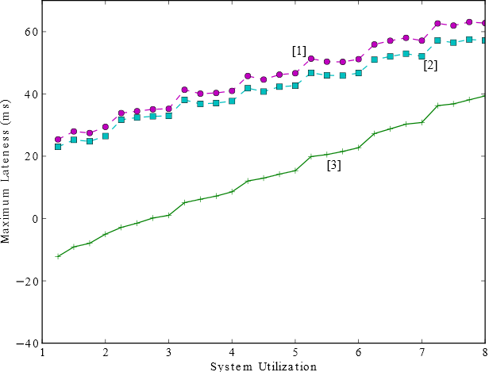
Results – Maximum Lateness

Slide 39
Results – Maximum Lateness
System Utilization

Slide 40
Results – Maximum Lateness
Maximum Lateness (from computed bounds)
System Utilization

Slide 41
Results – Maximum Lateness

Slide 42
Results – Maximum Lateness
EDF-DA

Slide 43
Results – Maximum Lateness
EDF-CVA

Slide 44
Results – Maximum Lateness
G-FL

Slide 45
Results – Maximum Lateness

Slide 46
Take Home Messages
Any GEL scheduler ensures bounded tardiness (or lateness) with no utilization loss.
  Actually, any window-constrained scheduler does.
G-EDF is not necessarily the best such algorithm.
Under CVA, G-FL provably has the lowest maximum lateness bounds.

Slide 47
Outline
Background.
  AKA “Real-Time 101.”
Tardiness bounds for global schedulers.
  Early bounds and several later improvements.
Scalability of global schedulers.
  Or, what happens when you really implement one…
Other issues.
  Enabling non-worst-case provisionings, dealing with I/O, precedence constraints, etc.
Future and ongoing work.

Slide 48
A Summary of What the Theory Says
At Least, for the Range of Schedulers We’ve Discussed
In this part of the talk, I’ll explain the
experimental process we’ve used to
answer this question and tell you the
answer this process yielded.
utilization loss tardiness
P-EDF up to m/2 0
GEL 0 > 0 (scheduler
dependent)
This comparison ignores overheads.
Which is the best scheduler for SRT, where
best is defined w.r.t schedulability and
tardiness with real overheads considered?

Slide 49
Overheads
Two basic kinds of overheads:
  Kernel overheads.
    Costs incurred due to kernel execution (which takes processor time away from tasks).
  Cache-related Preemption/Migration Delays (CPMDs).
    Costs incurred upon a preemption/migration due to a loss of cache affinity.
Can account for overheads by inflating task execution costs.
  Doing this correctly is a little tricky.

Slide 50

Our Software Development Platform
Linux Testbed for Multiprocessor Scheduling
in Real-Time systems
Real-time Linux extension originally developed at UNC.
  (Multiprocessor) scheduling and synchronization algorithms implemented as “plug-in” components.
  Developed as a kernel patch (currently based on Linux 3.10.5).
  Code is available at http://www.litmus-rt.org/.

Slide 51
Our Experimental Methodology
We use worst-case (average-case)
overheads for HRT (SRT).
Implement schedulers.
Use monotonic
piecewise linear interpolation
to compute overhead
expressions as a function of n.
Implement as
LITMUS^{RT} plugins.
Generate several million random
task sets and check schedulability
with overheads considered. Done
on a 500+ node research cluster.
Can take a day or more.
Record overheads.
Involves tracing the
behavior of 1,000s of
synthetic tasks in
LITMUS^{RT} on test
platform. Usually takes
8-12 hours. Yields many
gigabytes of trace data.
Distill overhead expressions.
Run schedulability experiments.

Slide 52
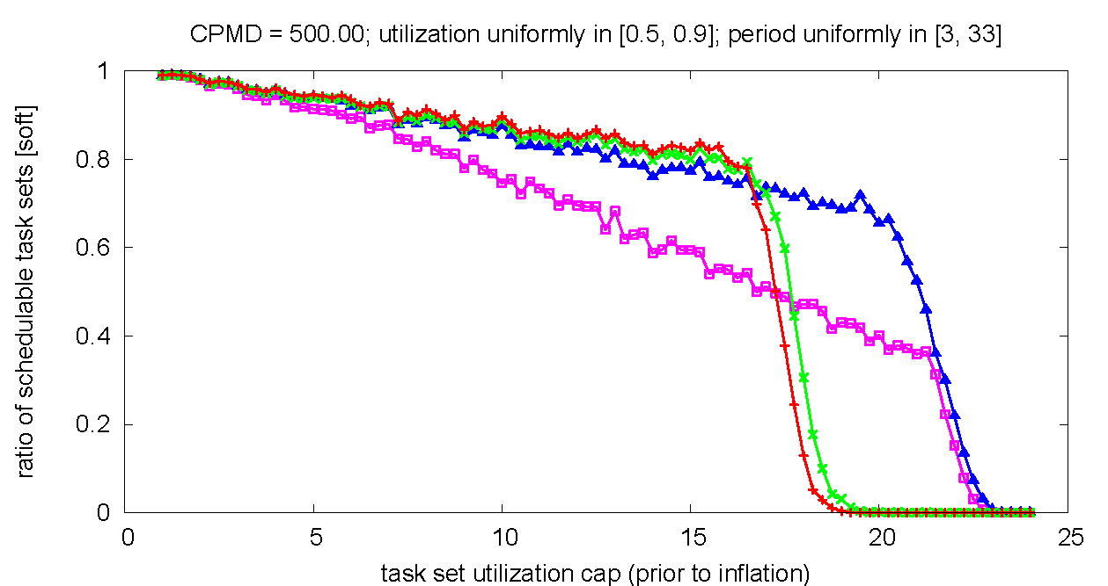
Example Schedulability Graph
24-Core Intel System
The system is broken into four
6-core clusters, where each cluster
has a shared L3 cache, and G-EDF
is used within each cluster.
SRT Schedulable Task Sets
Of the task systems with a
total utilization of 20, ~70%
were SRT schedulable under
C-EDF-L3, while none were
under P-EDF.
C-EDF-L3
P-EDF
Increasing task system utilization

Slide 53
What Such Studies Have Shown
Using G-EDF within clusters of size 2-8 yields the best SRT schedulability.
  Note that we did not test other GEL schedulers, but they have the same overheads and schedulability.
The resulting tardiness bounds tend to be in the range of 10’s of milliseconds.
  Such bounds are the lowest for G-FL.
Tardiness in actual schedules is quite rare.
New work by Björn Brandenburg
has shown that G-EDF can effectively
scale to 64 cores, but that work
considered only schedulability and not
tardiness bounds.

Slide 54
Outline
Background.
  AKA “Real-Time 101.”
Tardiness bounds for global schedulers.
  Early bounds and several later improvements.
Scalability of global schedulers.
  Or, what happens when you really implement one…
Other issues.
  Enabling non-worst-case provisionings, dealing with I/O, precedence constraints, etc.
Future and ongoing work.

Slide 55
Are You Really Going to Provision a SRT System Based on WCETs?
Chris Hobbs from QNX, at a panel
at EMSOFT we were both on a few
weeks ago [paraphrasing]: “Customers are telling us they don’t necessarily want HRT guarantees. They want probabilities.”
In reality, task execution times may vary widely.
A WCET-based provisioning of a SRT system doesn’t seem too reasonable.
But a (near-)average-case one does.
  But to talk about averages, we need stochastic analysis.
Average
Measured
Worst Case
Proven
Worst Case

Slide 56
Stochastic Sporadic Tasks
Main Ideas
Encapsulate each sporadic task τ within a “server” task S with deterministic parameters.
  S’s budget may be based on τ’s average exec. cost.
  ⇒ Multiple server allocations may be required to service one job of τ.
Server
Budget
Allocations
Job 1
Some jobs
of τ
Job 2
Job 3
How these
jobs execute
within budget
allocations
0 5 10 15 20 25 30 35 40

Slide 57
Stochastic Sporadic Tasks
Main Ideas
Encapsulate each sporadic task τ within a “server” task S with deterministic parameters.
  S’s budget may be based on τ’s average exec. cost.
  ⇒ Multiple server allocations may be required to service one job of τ.
Now have two sources of tardiness:
  Deterministic.
    Server tardiness, which can be calculated as I’ve shown.
  Stochastic.
    Job tardiness, which can be calculated using queuing theory.

Slide 58
Precedence Constraints
We’ve studied precedence constraints in the form of PGM graphs:
We’ve shown that bounded tardiness can be ensured for PGM graphs under GEL schedulers with no utilization loss.
  This result is a bit too complicated to explain in the short time remaining.
.
.
.
τ₁
.
tokens
τ₂
τ₃
.
.
.
τ₄

Slide 59
I/O
I/O-based suspensions cause utilization loss.
Uniprocessor Example:
  Two tasks with parameters (0.5 exec, 9.0 susp, 0.5 exec, period = 10).
  Low utilization but unbounded tardiness!
We’ve investigated several analysis
techniques for reducing such
utilization loss.
τ₁
CPU 1
τ₂
Suspension
0
5
10
15
20
25
Time

Slide 60
Outline
Background.
  AKA “Real-Time 101.”
Tardiness bounds for global schedulers.
  Early bounds and several later improvements.
Scalability of global schedulers.
  Or, what happens when you really implement one…
Other issues.
  Enabling non-worst-case provisionings, dealing with I/O, precedence constraints, etc.
Future and ongoing work.

Slide 61
Topics We are Currently Investigating
Tardiness in dynamic/overloaded systems.
Tardiness in container-based systems.
Stochastic analysis for systems with precedence and resource-sharing constraints.
Tardiness analysis for heterogeneous multiprocessor platforms.
Tardiness in mixed-criticality systems.

Slide 62
Thanks!
Questions?

Slide 63
References
Out of ~40 Papers We’ve Written on “SRT on Multiprocessors”
J. Erickson, J. Anderson, and B. Ward, “Fair Lateness Scheduling: Reducing Maximum Lateness in G-EDF-like Scheduling,” Real-Time Systems, to appear.
J. Erickson and J. Anderson, “Reducing Tardiness Under Global Scheduling by Splitting Jobs,” Proc. of the 25th Euromicro Conference on Real-Time Systems, July 2013
C. Liu and J. Anderson, “An O(m) Analysis Technique for Supporting Real-Time Self-Suspending Task Systems,” Proc. of the 33rd IEEE Real-Time Systems Symposium, Dec. 2012.
C. Kenna, J. Herman, B. Brandenburg, A. Mills, and J. Anderson, “Soft Real-Time on Multiprocessors: Are Analysis-Based Schedulers Really Worth It?,” Proc. of the 32nd IEEE Real-Time Systems Symposium, Dec. 2011.
J. Erickson, U. Devi, and S. Baruah, “Improved tardiness bounds for Global EDF,” Proc. of the 22nd Euromicro Conference on Real-Time Systems, July 2010.
C. Liu and J. Anderson, “Supporting Soft Real-Time DAG-based Systems on Multiprocessors with No Utilization Loss,” Proc. of the 31st IEEE Real-Time Systems Symposium, Dec. 2010.
A. Bastoni, B. Brandenburg, and J. Anderson, “An Empirical Comparison of Global, Partitioned, and Clustered Multiprocessor Real-Time Schedulers,” Proc. of the 31st IEEE Real-Time Systems Symposium, Dec. 2010.
H. Leontyev and J. Anderson, “Generalized Tardiness Bounds for Global Multiprocessor Scheduling,” Real-Time Systems (44)1: 26-71, Feb. 2010.
U. Devi and J. Anderson, “Tardiness Bounds under Global EDF Scheduling on a Multiprocessor,” Real-Time Systems 38(2): 133-189, Feb. 2008.

Slide 64
Extra Slides

Slide 65
Analysis Illustrated
= {(4,5),
(4,5),
(8,20)},
m = 2
C_{i}: WCET
T_{i}: Period
U_{i}: Util.
Y_{i}: PP
τ₁
x
C₁
τ₂
x
C₂
τ₃
x
C₃
Deadline

Slide 66
CVA Illustrated
= {(4,5),
(4,5),
(8,20)},
m = 2
C_{i}: WCET
T_{i}: Period
U_{i}: Util.
Y_{i}: PP
Recall prior illustration of the original G-EDF analysis:
τ₁
x
C₁
τ₂
x
C₂
τ₃
x
C₃
Deadline

Slide 67
CVA Illustrated
= {(4,5),
(4,5),
(8,20)},
m = 2
C_{i}: WCET
T_{i}: Period
U_{i}: Util.
Y_{i}: PP
Here is the corresponding illustration when CVA is applied to G-EDF:
τ₁
x₁
C₁
τ₂
x₂
C₂
τ₃
x₃
C₃
Deadline

Slide 68
Improving These Results
These tardiness bounds all depend on the C_{i}’s.
  In fact, tardiness → 0 as max C_{i} → 0.
⇒ tardiness can be decreased via “job slicing.”
  E.g., τ_{i} = (4,10) becomes τ_{i} = (2,5).
[Erickson & Anderson ‘13] showed that job slicing commonly reduces tardiness bounds by 25% to 80%.
  In this work, slicing was done w.r.t. to budget allocations and complications such as increased overheads and critical sections were considered.

Slide 69
Dealing with Suspensions
Easy Approach: Analytically treat suspension time as computation time.
  This is safe.
    Intuitively, job completion times can only move to the right.
  But utilization loss is Θ(n).
Better Approach: Only selectively treat some suspensions as computation time.
  Can improve utilization loss to Θ(m).
  We’ll skip the details…

Slide 70
Compliant Vector Analysis
(CVA)
= {(4,5),
(4,5),
(8,20)},
m = 2
C_{i}: WCET
T_{i}: Period
U_{i}: Util.
Y_{i}: PP
New twist: Instead of a single x, we have an x_{i} per each task τ_{i}.
  Generalizing the prior analysis to an arbitrary GEL algorithm, each task τ_{i}’s response time will be at most Y_{i} + x_{i} + C_{i} (instead of T_{i} + x + C_{i}).
Define x as the vector ⟨x₁, x₂, …, x_{n}⟩.
Our goal: Find x.
  Note: We assume all PPs are reduced by min(Y_{i}), as this improves the analysis without changing the schedule.

Slide 71
Finding (Vector) x
= {(4,5),
(4,5),
(8,20)},
m = 2
C_{i}: WCET
T_{i}: Period
U_{i}: Util.
Y_{i}: PP
[Erickson et. al ‘10] showed that there exists a constant s such that x_{i} = v_{i}(s), where
New goal: Find s.

Slide 72
Finding s
= {(4,5),
(4,5),
(8,20)},
m = 2
C_{i}: WCET
T_{i}: Period
U_{i}: Util.
Y_{i}: PP
[Erickson et. al ‘10] showed that s is given by G(s) + S(τ), where
s can be computed by finding the zero of M(s) = G(s) + S(τ) − s (which is unique).

Slide 73
Example
= {(4,5),
(4,5),
(8,20)},
m = 2
C_{i}: WCET
T_{i}: Period
U_{i}: Util.
Y_{i}: PP
CVA Summary
Assuming G-EDF, Y₁ = Y₂ = 5, and Y₃ = 20, but reducing by Y_{min} gives, Y₁ = Y₂ = 0, and Y₃ = 15.
S₁ = S₂ = 4⋅(1 − 0) = 4, S₃ = 8⋅(1 − (15/20)) = 2, and S(τ) = 4 + 4 + 2 = 10.
The summand for G(s) is maximized either when i = 1 or 2 or when i = 3. After some simplification, G(s) = max((2s − 8)/5, (s + 22)/5).
Now, we have completely characterized M(s) and its zero of s = 18 can be computed.

Slide 74
Example
= {(4,5),
(4,5),
(8,20)},
m = 2
C_{i}: WCET
T_{i}: Period
U_{i}: Util.
Y_{i}: PP
CVA Summary
Assuming G-EDF, Y₁ = Y₂ = 5, and Y₃ = 20, but reducing by Y_{min} gives, Y₁ = Y₂ = 0, and Y₃ = 15.
S₁ = S₂ = 4⋅(1 − 0) = 4, S₃ = 8⋅(1 − (15/20)) = 2, and S(τ) = 4 + 4 + 2 = 10.
G(s) = max((2s − 8)/5, (s + 22)/5).
The zero of M(s) is s = 18.
Thus, x₁ = x₂ = (18 − 4)/2 = 7 and x₃ = (18 − 8)/2 = 5.
τ₁ & τ₂ have resp. time Y_{i}+x_{i}+C_{i} = 0+7+4 = 11 and late- ness 11−T_{i} = 6. Similarly, τ₃ has r.t. (lateness) 28 (8).

Slide 75
G-FL
= {(4,5),
(4,5),
(8,20)},
m = 2
C_{i}: WCET
T_{i}: Period
U_{i}: Util.
Y_{i}: PP
[Erickson & Anderson ‘12] showed that the best maximum lateness bounds under CVA are obtained when Y_{i} = T_{i} − ((m − 1)/m)⋅C_{i}.
  They called this GEL algorithm global fair lateness (G-FL).
  As before, it is desirable to analytically assume all Y_{i}’s are reduced by Y_{min}.
Ex: We have Y₁ = Y₂ = 5 − (1/2)⋅4 = 3 and Y₃ = 20 − (1/2)⋅8 = 16. After reducing, Y₁ = Y₂ = 0 and Y₃ = 13.

Slide 76
Linear Programming
= {(4,5),
(4,5),
(8,20)},
m = 2
C_{i}: WCET
T_{i}: Period
U_{i}: Util.
Y_{i}: PP
G-FL has the best maximum lateness bounds under CVA.
However, other PP settings may yield the same maximum bounds but lower bounds for individual tasks.
Lateness bounds can be optimized for different objectives by formulating CVA as a linear program.

Slide 77
LP Formulation of CVA
= {(4,5),
(4,5),
(8,20)},
m = 2
C_{i}: WCET
T_{i}: Period
U_{i}: Util.
Y_{i}: PP
Constraint Set 1:
  ∀i: x_{i} = (s − C_{i})/m.
Constraint Set 2:
  ∀i: S_{i} ≥ 0,
  ∀i: S_{i} ≥ C_{i}⋅(1 − Y_{i}/T_{i}).
CVA Summary

Slide 78
LP Formulation of CVA
= {(4,5),
(4,5),
(8,20)},
m = 2
C_{i}: WCET
T_{i}: Period
U_{i}: Util.
Y_{i}: PP
Constraint Set 1:
  ∀i: x_{i} = (s − C_{i})/m.
Constraint Set 2:
  ∀i: S_{i} ≥ 0,
  ∀i: S_{i} ≥ C_{i}⋅(1 − Y_{i}/T_{i}).
CVA Summary

Slide 79
LP Formulation of CVA
= {(4,5),
(4,5),
(8,20)},
m = 2
C_{i}: WCET
T_{i}: Period
U_{i}: Util.
Y_{i}: PP
Constraint Set 1:
  ∀i: x_{i} = (s − C_{i})/m.
Constraint Set 2:
  ∀i: S_{i} ≥ 0,
  ∀i: S_{i} ≥ C_{i}⋅(1 − Y_{i}/T_{i}).
CVA Summary

Slide 80
LP Formulation of CVA
= {(4,5),
(4,5),
(8,20)},
m = 2
C_{i}: WCET
T_{i}: Period
U_{i}: Util.
Y_{i}: PP
Constraint Set 1:
  ∀i: x_{i} = (s − C_{i})/m.
Constraint Set 2:
  ∀i: S_{i} ≥ 0,
  ∀i: S_{i} ≥ C_{i}⋅(1 − Y_{i}/T_{i}).
CVA Summary

Slide 81
LP Formulation of CVA
= {(4,5),
(4,5),
(8,20)},
m = 2
C_{i}: WCET
T_{i}: Period
U_{i}: Util.
Y_{i}: PP
Constraint Set 1:
  ∀i: x_{i} = (s − C_{i})/m.
Constraint Set 2:
  ∀i: S_{i} ≥ 0,
  ∀i: S_{i} ≥ C_{i}⋅(1 − Y_{i}/T_{i}).
How do we deal with a constraint like this?
CVA Summary

Slide 82
Detour
We can compute the sum of the largest k elements in a set A = {a₁,…,a_{n}} as follows:
  Minimize G
  Subject to
    G = kb + Σ_{i=1,…,n} z_{i},
    ∀i: z_{i} ≥ 0,
    ∀i: z_{i} ≥ a_{i} − b.
  where G, b, and z_{i} are variables, k and a_{i} are constants.

Slide 83
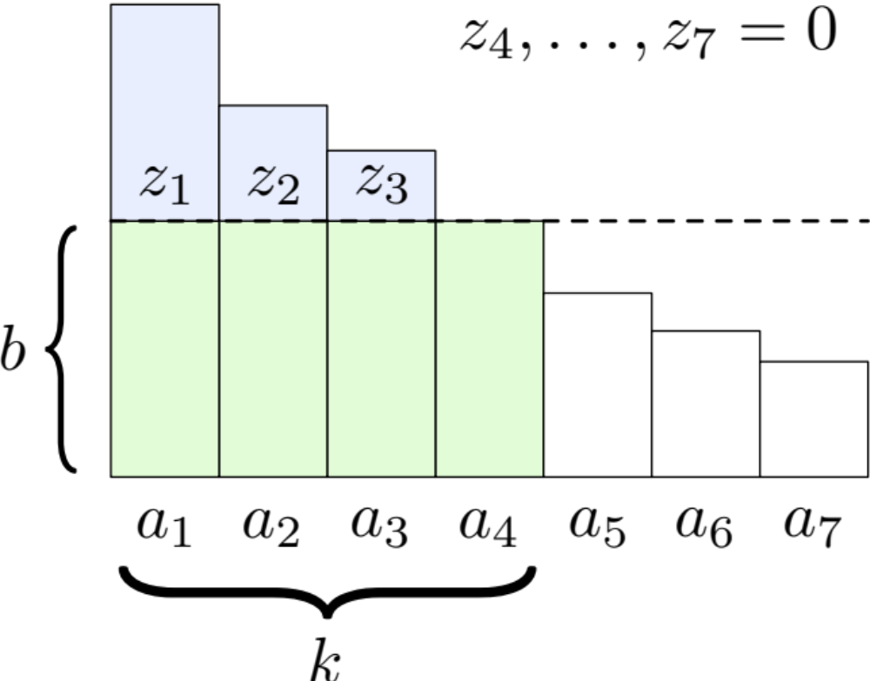
Detour (Cont’d)
Minimize G
Subject to
  G = kb + Σ_{i=1,…,n} z_{i},
  ∀i: z_{i} ≥ 0,
  ∀i: z_{i} ≥ a_{i} − b.

Slide 84
Detour (Cont’d)
Minimize G
Subject to
  G = kb + Σ_{i=1,…,n} z_{i},
  ∀i: z_{i} ≥ 0,
  ∀i: z_{i} ≥ a_{i} − b.

Slide 85
Detour (Cont’d)
Minimize G
Subject to
  G = kb + Σ_{i=1,…,n} z_{i},
  ∀i: z_{i} ≥ 0,
  ∀i: z_{i} ≥ a_{i} − b.

Slide 86
Detour (Cont’d)
Minimize G
Subject to
  G = kb + Σ_{i=1,…,n} z_{i},
  ∀i: z_{i} ≥ 0,
  ∀i: z_{i} ≥ a_{i} − b.

Slide 87
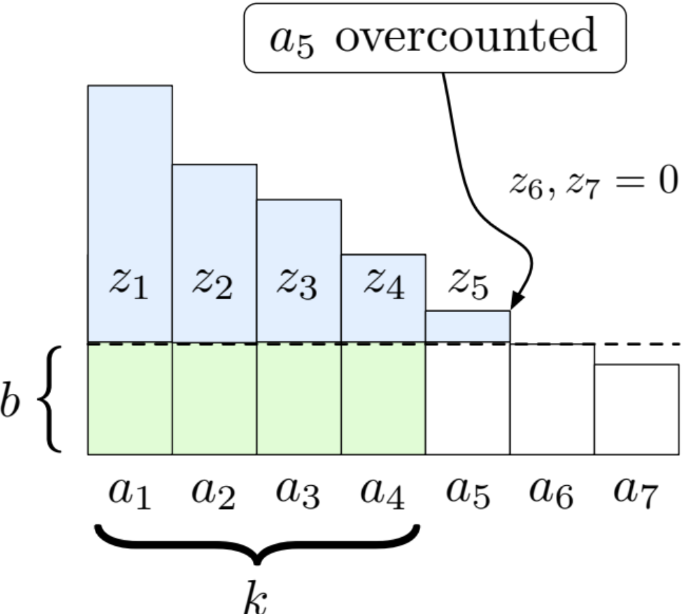
Detour (Cont’d)
Minimize G
Subject to
  G = kb + Σ_{i=1,…,n} z_{i},
  ∀i: z_{i} ≥ 0,
  ∀i: z_{i} ≥ a_{i} − b.

Slide 88
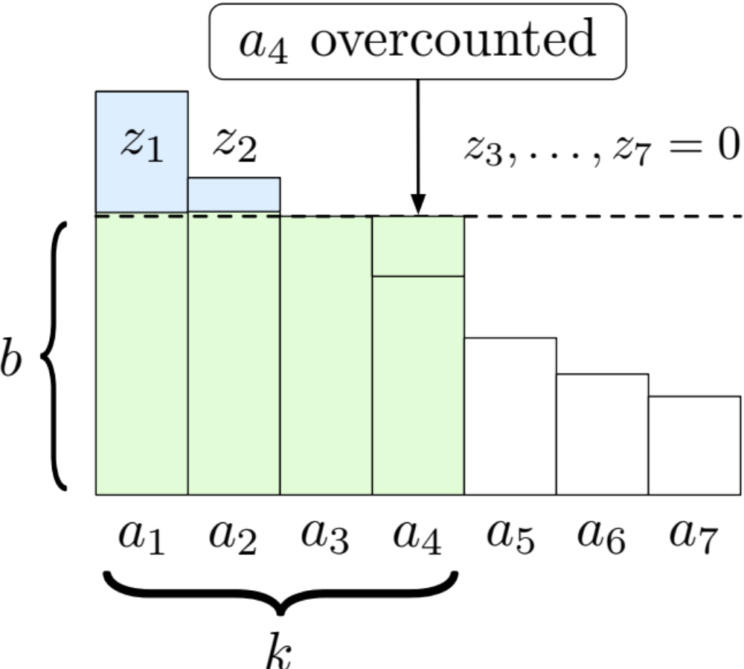
Detour (Cont’d)
Minimize G
Subject to
  G = kb + Σ_{i=1,…,n} z_{i},
  ∀i: z_{i} ≥ 0,
  ∀i: z_{i} ≥ a_{i} − b.

Slide 89
LP Formulation of CVA
= {(4,5),
(4,5),
(8,20)},
m = 2
C_{i}: WCET
T_{i}: Period
U_{i}: Util.
Y_{i}: PP
Constraint Set 1:
  ∀i: x_{i} = (s − C_{i})/m.
Constraint Set 2:
  ∀i: S_{i} ≥ 0,
  ∀i: S_{i} ≥ C_{i}⋅(1 − Y_{i}/T_{i}).
Constraint Set 3:
  G(s) = b⋅(m − 1) + Σ_{τ ∈τ} z_{i},
  ∀i: z_{i} ≥ 0,
  ∀i: z_{i} ≥ x_{i}⋅U_{i} + C_{i} − S_{i} − b.
CVA Summary
_{i}
Minimize G
Subject to
  G = kb + Σ_{i=1,…,n} z_{i},
  ∀i: z_{i} ≥ 0,
  ∀i: z_{i} ≥ a_{i} − b.

Slide 90
LP Formulation of CVA
= {(4,5),
(4,5),
(8,20)},
m = 2
C_{i}: WCET
T_{i}: Period
U_{i}: Util.
Y_{i}: PP
Constraint Set 1:
  ∀i: x_{i} = (s − C_{i})/m.
Constraint Set 2:
  ∀i: S_{i} ≥ 0,
  ∀i: S_{i} ≥ C_{i}⋅(1 − Y_{i}/T_{i}).
Constraint Set 3:
  G(s) = b⋅(m − 1) + Σ_{τ ∈τ} z_{i},
  ∀i: z_{i} ≥ 0,
  ∀i: z_{i} ≥ x_{i}⋅U_{i} + C_{i} − S_{i} − b.
CVA Summary
_{i}
Minimize G
Subject to
  G = kb + Σ_{i=1,…,n} z_{i},
  ∀i: z_{i} ≥ 0,
  ∀i: z_{i} ≥ a_{i} − b.

Slide 91
LP Formulation of CVA
= {(4,5),
(4,5),
(8,20)},
m = 2
C_{i}: WCET
T_{i}: Period
U_{i}: Util.
Y_{i}: PP
Constraint Set 1:
  ∀i: x_{i} = (s − C_{i})/m.
Constraint Set 2:
  ∀i: S_{i} ≥ 0,
  ∀i: S_{i} ≥ C_{i}⋅(1 − Y_{i}/T_{i}).
Constraint Set 3:
  G(s) = b⋅(m − 1) + Σ_{τ ∈τ} z_{i},
  ∀i: z_{i} ≥ 0,
  ∀i: z_{i} ≥ x_{i}⋅U_{i} + C_{i} − S_{i} − b.
Constraint Set 4:
  S(τ) = Σ_{τ ∈τ} S_{i}.
CVA Summary
_{i}
_{i}

Slide 92
LP Formulation of CVA
= {(4,5),
(4,5),
(8,20)},
m = 2
C_{i}: WCET
T_{i}: Period
U_{i}: Util.
Y_{i}: PP
Constraint Set 1:
  ∀i: x_{i} = (s − C_{i})/m.
Constraint Set 2:
  ∀i: S_{i} ≥ 0,
  ∀i: S_{i} ≥ C_{i}⋅(1 − Y_{i}/T_{i}).
Constraint Set 3:
  G(s) = b⋅(m − 1) + Σ_{τ ∈τ} z_{i},
  ∀i: z_{i} ≥ 0,
  ∀i: z_{i} ≥ x_{i}⋅U_{i} + C_{i} − S_{i} − b.
Constraint Set 4:
  S(τ) = Σ_{τ ∈τ} S_{i}.
CVA Summary
_{i}
_{i}

Slide 93
LP Formulation of CVA
= {(4,5),
(4,5),
(8,20)},
m = 2
C_{i}: WCET
T_{i}: Period
U_{i}: Util.
Y_{i}: PP
Constraint Set 1:
  ∀i: x_{i} = (s − C_{i})/m.
Constraint Set 2:
  ∀i: S_{i} ≥ 0,
  ∀i: S_{i} ≥ C_{i}⋅(1 − Y_{i}/T_{i}).
Constraint Set 3:
  G(s) = b⋅(m − 1) + Σ_{τ ∈τ} z_{i},
  ∀i: z_{i} ≥ 0,
  ∀i: z_{i} ≥ x_{i}⋅U_{i} + C_{i} − S_{i} − b.
Constraint Set 4:
  S(τ) = Σ_{τ ∈τ} S_{i}.
CVA Summary
_{i}
Constraint Set 5:
  G(s) + S(τ) = s.
_{i}

Slide 94
LP Formulation of CVA
= {(4,5),
(4,5),
(8,20)},
m = 2
C_{i}: WCET
T_{i}: Period
U_{i}: Util.
Y_{i}: PP
Constraint Set 1:
  ∀i: x_{i} = (s − C_{i})/m.
Constraint Set 2:
  ∀i: S_{i} ≥ 0,
  ∀i: S_{i} ≥ C_{i}⋅(1 − Y_{i}/T_{i}).
Constraint Set 3:
  G(s) = b⋅(m − 1) + Σ_{τ ∈τ} z_{i},
  ∀i: z_{i} ≥ 0,
  ∀i: z_{i} ≥ x_{i}⋅U_{i} + C_{i} − S_{i} − b.
Constraint Set 4:
  S(τ) = Σ_{τ ∈τ} S_{i}.
CVA Summary
_{i}
Constraint Set 5:
  G(s) + S(τ) = s.
_{i}

Slide 95
LP Formulation of CVA
= {(4,5),
(4,5),
(8,20)},
m = 2
C_{i}: WCET
T_{i}: Period
U_{i}: Util.
Y_{i}: PP
Constraint Set 1:
  ∀i: x_{i} = (s − C_{i})/m.
Constraint Set 2:
  ∀i: S_{i} ≥ 0,
  ∀i: S_{i} ≥ C_{i}⋅(1 − Y_{i}/T_{i}).
Constraint Set 3:
  G(s) = b⋅(m − 1) + Σ_{τ ∈τ} z_{i},
  ∀i: z_{i} ≥ 0,
  ∀i: z_{i} ≥ x_{i}⋅U_{i} + C_{i} − S_{i} − b.
Constraint Set 4:
  S(τ) = Σ_{τ ∈τ} S_{i}.
CVA Summary
_{i}
Constraint Set 5:
  G(s) + S(τ) = s.
_{i}

Slide 96
Minimizing Average Lateness
= {(4,5),
(4,5),
(8,20)},
m = 2
C_{i}: WCET
T_{i}: Period
U_{i}: Util.
Y_{i}: PP
CVA Summary
Minimize:
  Σ_{τ} _{∈τ} Y_{i} + x_{i}
Subject to:
  Constraint Sets 1-5.
Note: May produce a larger maximum lateness than G-FL.
Also, average lateness is really (Σ_{τ} _{∈τ} Y_{i} + x_{i} + C_{i} - T_{i})/n, but n and the C_{i}’s and T_{i}’s are constants.
_{i}

Slide 97
Minimizing Average Lateness from G-FL
= {(4,5),
(4,5),
(8,20)},
m = 2
C_{i}: WCET
T_{i}: Period
U_{i}: Util.
Y_{i}: PP
CVA Summary
Minimize:
  Σ_{τ} _{∈τ} Y_{i} + x_{i}
Subject to:
  ∀i: Y_{i} + x_{i} + C_{i} − T_{i} ≤ L_{max},
    where L_{max} is the maximum lateness bound from G-FL.
  Constraint Sets 1-5.
_{i}

Slide 98
Stochastic Sporadic Tasks
Main Ideas
Modify earlier sporadic task model so that only the mean and variance of a task τ_{i}’s execution time are specified.
  WCETs are neither needed nor required to exist!
Encapsulate each sporadic task τ_{i} within a “server” S_{i} that executes like a sporadic task with deterministic parameters.
  E.g., can define S_{i}’s budget to match τ_{i}’s average execution time.

Slide 99
Stochastic Sporadic Tasks (Cont’d)
Main Ideas
Tardiness bounds for S_{i} can be computed using the analysis already presented.
  This part is deterministic.
Because we are not provisioning on the worst case, several budget allocations to S_{i} may be required to service one job of τ_{i}.
  The number of such allocations can be determined by applying single-server queueing analysis to S_{i}.
  This yields a stochastic tardiness component.

Slide 100
Example
Multiple server allocations may
be required to process a single job.
Suppose the servers S = {(4,5), (4,5), (8,20)} encapsulate stochastic sporadic tasks τ with average utilizations {0.8, 0.8, 0.4}, where m = 2.
Assuming G-EDF, we could get this schedule:
interval during which a single job of some τ_{i} executes
CPU 1
S₁
CPU 2
S₂
S₃
0
5
10
15
20
25
Time

Slide 101
A Few Additional Details
Good averages and variances are easy to compute experimentally.
The stochastic analysis is done over specified time windows.
  Independence is required across windows.
    Larger windows yield less of a reliance on independence. But this also results in looser tardiness bounds.
As a byproduct of the analysis, quantiles of the tardiness distribution can be computed.
To demonstrate its effectiveness, we applied this analysis to a video decoding case study.

