Slide 1

Resource Augmentation for Performance Guarantees in Embedded Real-time Systems
Abhilash Thekkilakattil
Mälardalen University, Västerås, Sweden

Slide 2
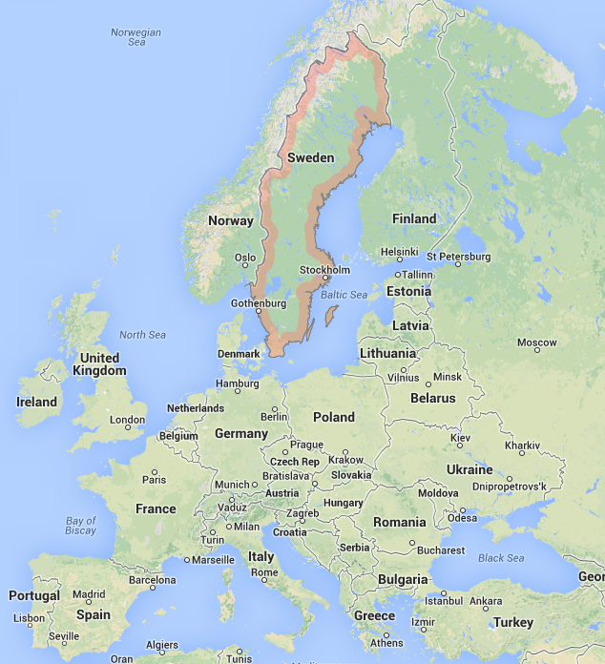
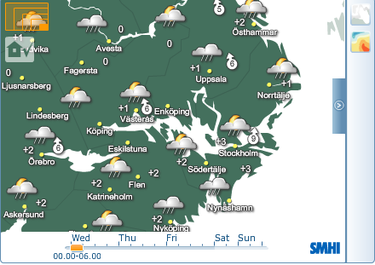

Mälardalen University- Sweden
Västerås
Stockholm

Slide 3




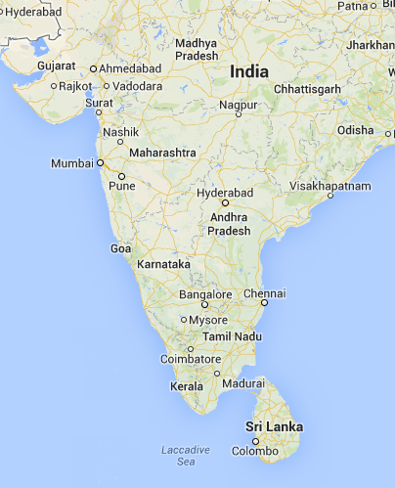








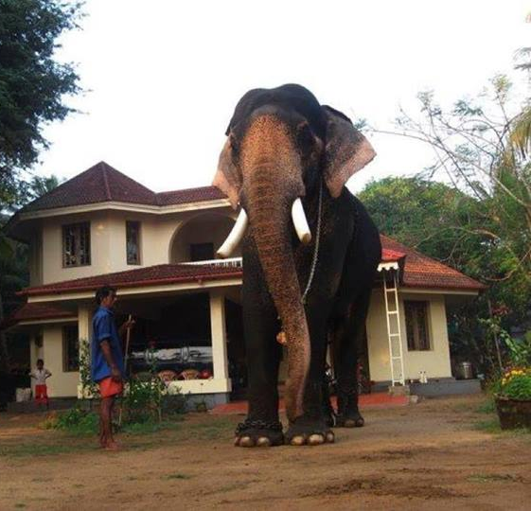
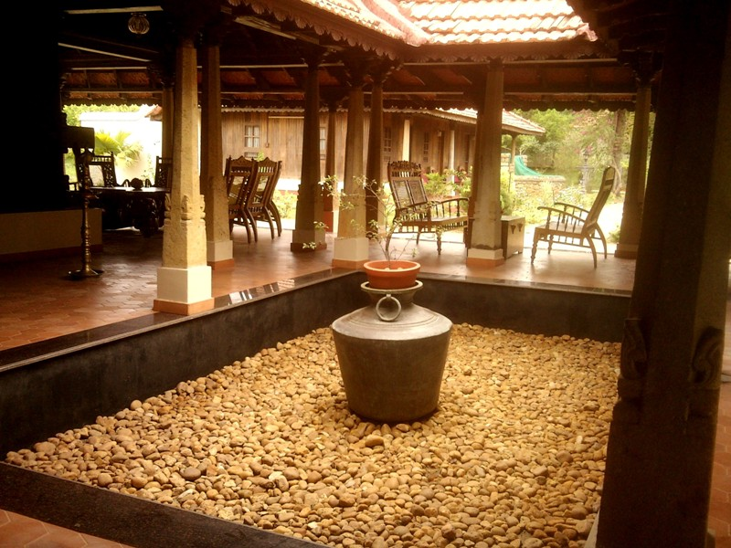

Kerala, India

Slide 4
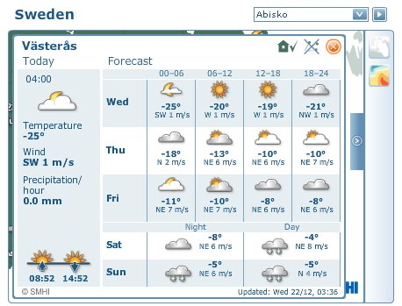






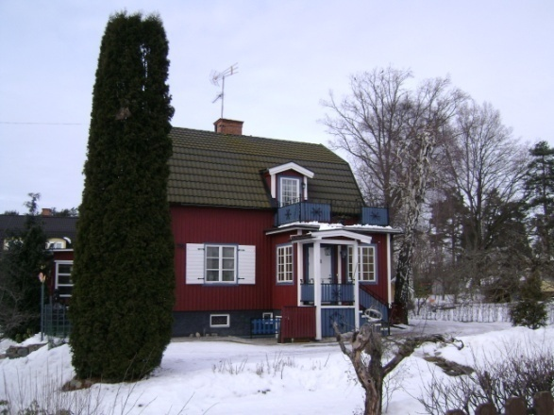
Västerås

Slide 5




The Dependable Real-time Systems Group
Sasikumar Punnekkat
Radu Dobrin
Huseyin Aysan
Abhilash Thekkilakattil
Real-time systems, Dependability- reliability, safety, testing etc

Slide 6
Overview of my Research
Resource Augmentation in Real-time Systems
Preemption Control
Fault Tolerance

Slide 7
Preemptive vs. Non-preemptive Scheduling
Feasibility: Does a schedule exists that guarantees no deadline misses for a given real-time task set?
Preemptive Scheduling
Non-preemptive Scheduling
Preemptive EDF is uniprocessor optimal
Strict domination of preemptive scheduling paradigm
Fairly well investigated
No algorithm is uniprocessor optimal under non-idling paradigm
No online non-preemptive scheduler with inserted idle times exists
Less investigated compared to preemptive scheduling

Slide 8
Preemptive vs. Non-preemptive Scheduling
Set of uniprocessor feasible task sets
Set of non-idling non-preemptive feasible task sets
Non-preemptive EDF
Limited preemptive EDF
Set of limited preemptive feasible task sets
Preemptive EDF
Question: How good is non-preemptive scheduling when compared to uniprocessor optimal (preemptive) scheduling algorithms?

Slide 9

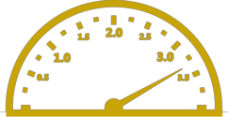
State of the Art
    The efficiency of a scheduler is commonly measured by resource augmentation
      how much extra resources (CPU) are required to reach optimality?
?
EDF feasibility
FPS feasibility
Task model | Preemptive (EDF vs. FPS) | Non-preemptive (EDF vs. FPS)
Implicit deadline | 1.44269 | 1.76322 - 2
Constrained deadline | 1.76322
Arbitrary deadline | 1.76322 - 2
?
Preemptive
EDF feasibility
Non-preemptive EDF feasibility
Davis et al

Slide 10
System Model
Constrained deadline sporadic task sets (deadline ≤ period)
Worst Case Execution Time scales linearly with processor speed
Limited-preemptive scheduler
  Floating non-preemptive region (f-NPR) scheduler
Task j (high priority)
max. length of f-NPR = L_{i}
Task i (low priority)
Notes:
----- Meeting Notes (2013-05-22 10:04) -----
relaxing assumption

Slide 11

Limited-Preemption Feasibility Analysis
Feasibility condition:
DBF(D_{k})
DBF(D_{j})
L_{i} + DBF(D_{j}) ≤ D_{j}
L_{i} + DBF(D_{k}) ≤ D_{k}
D_{k}
Task k
D_{j}
Task j
L_{i}
D_{i}
Task i
S.Baruah, The limited-preemption uniprocessor scheduling of sporadic task systems, ECRTS’05

Slide 12

Limited-Preemption Feasibility Analysis
Feasibility condition:
DBF(D_{j})
L_{i} + DBF(D_{k}) ≤ D_{k}
D_{k}
Task k
D_{j}
Task j
L_{i}
D_{i}
Task i
S.Baruah, The limited-preemption uniprocessor scheduling of sporadic task systems, ECRTS’05

Slide 13

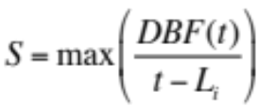
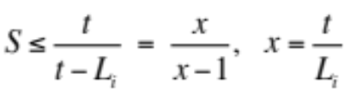
Limited-Preemption Feasibility Analysis
Feasibility condition:
DBF(D_{j})
D_{k}
Task k
D_{j}
speed-up
Task j
L_{i}
D_{i}
Task i

Slide 14
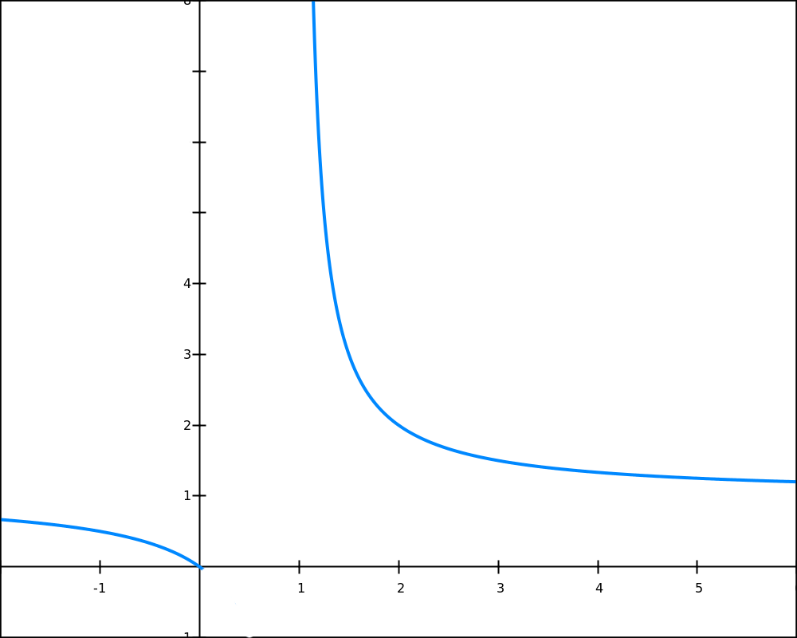

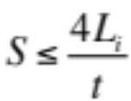


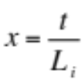
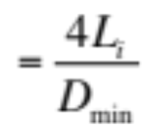
Processor Speed-up Bound
Speed (S)
Proof in the paper
?
The maximum S

Slide 15
Preemption Behavior vs. Processor Speed
Slower
1
Processor
Speed
4L/D_{min}
All feasible task sets are guaranteed a non-preemptive execution for L units
Faster
All feasible task sets are guaranteed a fully
non-preemptive schedule
4C_{max}/D_{min}
Feasibility Bucket
Set of uniprocessor feasible task sets
Set of limited-preemption feasible task sets
Set of non-idling non-preemptive feasible task sets on a uniprocessor

Slide 16
Scheduler Specific Overheads
Preemptive Scheduling
Non-preemptive Scheduling
Zero blocking: high utilization
High runtime overhead: preemption costs
Need for costly synchronization protocols
Low runtime overhead: zero preemption costs
☺ Mutual exclusion by construction
Increased blocking: low utilization
high priority
high priority
preemption cost
preemption cost
blocking
low priority
low priority
Limited-Preemption Scheduling
Best of preemptive and non-preemptive: preempt only when necessary
high priority
Bounded non-preemptive region
low priority

Slide 17
Scheduler Specific Overheads
☹ No control on the bound on number of preemptions
high priority
Limited-preemption
scheduler
Bounded max. length of f-NPR
☹ Limited control on the preemption points
low priority
Our method:
☺ Control the bound on the number of preemptions
high priority
Vary the bound on
the max length of f-NPR
Bounded max. length of f-NPR
☺ Full control on the preemption points: possibility to minimize preemption overheads
low priority

Slide 18
Minimizing Preemption Related Overheads
Preferred preemption points
Max. no. of preemptions
Derivation of non-preemptive regions
Task attributes
Step 1
Largest non-preemptive regions
Sensitivity analysis
Step 2
Minimum processor speed that guarantees feasibility

Slide 19
Step 1: Deriving f-NPRs
We use processor speed-up
Max. length of the desirable f-NPR
Default max. length of f-NPR
Task i
Task level requirements:
Req. 1: Bound the number of preemptions
Req. 2: Enable preemptions at optimal points
Preferred preemption points ( )

Slide 20

Step 2: Sensitivity Analysis
Slower
1
Processor
Speed
4L/D_{min}
Faster
Max. length of the desirable f-NPR
4C_{max}/D_{min}
Default max. length of f-NPR
speed
speed
speed
speed
speed
speed
min = 1
optimal
max =

Slide 21
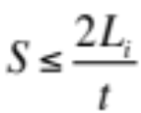
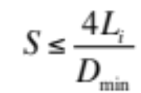
Tightening the Augmentation Bound
Speed (S)
Less pessimistic
unified result:

Slide 22
Summary
  Quantification of the sub-optimality of non-preemptive scheduling
    Non-preemptive scheduling is not uniprocessor optimal under the work conserving paradigm
    Optimal online non-preemptive scheduler with inserted idle times cannot exist
    Our contribution allows to use processor speed-up to enable non-preemptive feasibility for arbitrary task sets
  Analysis of preemption behavior vs. processor speed: the feasibility bucket
  Method to minimize preemption overheads
      Derivation of non-preemption requirements
      Sensitivity analysis to calculate the optimal speed-up

Slide 23
Future Work
Size of the shape is not indicative of the size of the set !
m processors feasible
Slower
1
Processor
Speed
4L/D_{min}
?
?
4C_{max}/D_{min}
Faster
?
?
Set of uniprocessor feasible task sets
Set of limited-preemption feasible task sets
Set of non-idling non-preemptive feasible task sets on a uniprocessor
Set of m-processor feasible task sets
Set of limited-preemption feasible task sets on multi-processors
Set of non-idling non-preemptive feasible task sets on multi-processors

Slide 24
Future Work
  Quantification of the sub-optimality of non-preemptive FPS
    Bound on the speed-up required to guarantee non-preemptive FPS schedulability for all feasible task sets
    Interesting in the context of automotive systems
  Comparing preemptive FPS and non-preemptive FPS
    Which is better in terms of resource augmentation?
    Currently no means of comparison exists

Slide 25
Overview
Resource Augmentation for Real-time Systems
Preemption Control
Fault Tolerance

Slide 26

Fault Tolerant Real-time Scheduling
Temporal redundancy under transient faults
Fault tolerance related overhead
Fault tolerance feasibility (FT-feasibility): existence of a real-time schedule that is fault tolerant under a specified fault hypothesis
    Transient faults
    Temporal redundancy
Guaranteeing FT-feasibility: ensure sufficient slack for at least one successful execution of all the tasks
    Control fault tolerance related overheads
    Control task execution times

Slide 27
Fault Tolerance Feasibility
traditional FT-feasibility analysis
error burst
faults/errors as singleton events
Nature of errors
  Normally continuous events e.g., a vehicle passing through electromagnetic fields
  Occur continuously over a period of time: error bursts
Challenging to handle in classical FT-feasibility analysis
  Need to map continuous events into singleton events
How can we guarantee FT-feasibility under error bursts?
  Hypothesis: use a faster processor

Slide 28
Problem Description
Questions:
  How can we perform an FT-feasibility analysis for a given set of temporally redundant real-time tasks under a specified error burst length?
  If the real-time task set is not found to be FT-feasible, what is the lowest processor speed that guarantees its FT-feasibility under the error burst?

Slide 29
Definitions
worst case error overhead (E_{t})
T_{length}
ε
T_{length}
ε
t
wasted execution time
∑
maximum
wasted execution time
=
Worst Case Temporal Wastage
(W_{err}(t))

Slide 30
Assumptions
Error detection
abs. deadline of τ_{i}
τ_{i}
t’
t
Scheduler: Fault Tolerant Earliest Deadline First (FT-EDF)- schedule task executions and re-execution according to their deadlines
Objective: find the Worst Case Temporal Wastage at time t
  Break down into cases
Strategy: we assume that there are no deadline misses under the error burst and derive the sufficient condition for this to be true

Slide 31
Case 1
Worst Case Temporal Wastage at t when the error burst
hits only a single job
τ_{k}
scenario A: W_{err}(t)=2(Ck – ε)
τ_{j}
τ_{i}
t’
t
scenario B: W_{err}(t)= 2(Cj – ε)
τ_{k}
τ_{j}
τ_{i}
τ_{k}
t’
t
τ_{j}
scenario C: W_{err}(t)= 2(Ci – ε)
τ_{i}
t’
t

Slide 32
Case 2
Worst Case Temporal Wastage at t when the error burst
hits more than one job
W_{err}(t) =
2(C_{i} – ε)
+
∑ (C_{m} – ε)
, D_{m} ≤ D_{i}
T_{length}
ε
(Cl – ε)
τ_{l}
ε
(Ck – ε)
τ_{k}
ε
(Cj – ε)
τ_{j}
ε
(Ci – ε)
ε
(Ci – ε)
τ_{i}
t’
t

Slide 33
Case 3
Worst Case Temporal Wastage at the absolute deadline of a job that is not hit by the error burst
overhead at d_{k} = overhead at t
overhead at d_{k} = overhead at d_{(k-1)}
τ_{j}
(abs. deadline of τ_{i})
τ_{i}
t
d(k-1)
dk
t’
Under EDF, the tasks released in the interval [t’,t] having a deadline greater than t are not hit by the error burst

Slide 34
Worst Case Temporal Wastage: General Case
Case 1 : max{2(Ck – ε)} , Dk ≤ Di
When the error burst hits only a single job
Case 2 : 2(Ci – ε) + ∑ (Ck – ε) , Dk ≤ Di
When the error burst hits more than one job
W_{err}(t) = Max
t is the absolute
deadline of a task τ_{i}
Case 3 : WCTW at the previous absolute deadline
If τ_{i} is not hit by the error burst

Slide 35
FT-Feasibility: A Sufficient Condition
E_{t}
T_{length}
DBF(t)
t
E_{t} = W_{err}(t) + T_{length}
E_{t} + DBF(t) ≤ t

Slide 36
Problem Description
Questions:
  How can we perform an FT-feasibility analysis for a given set of temporally redundant real-time tasks under a specified error burst length?
  If the real-time task set is not found to be FT-feasible, what is the lowest processor speed that guarantees its FT-feasibility under the error burst?

Slide 37
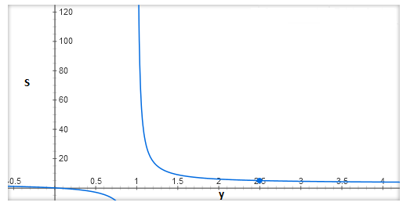
Resource Augmentation for FT-feasibility
deadline miss
DBF(t)/S
T_{length}
DBF(t)
DBF(t)
t
X + Y = Werr(t)
X + Y’ = Werr(t) /S
Is S bounded ?
S = max{(DBF(t)+ W_{err}(t) )/ (t -T_{length})}
Put W_{err}(t) = 2DBF(t) and DBF(t) = t
S ≤ 3t/(t - T_{length} )
S ≤ 3y/(y-1) [ y = t/ T_{length} ]
S ≤ 6 [ y ≥ 2 => T_{length} ≤ D_{min}/2 ]

Slide 38
Mixed Criticality Fault Tolerant Scheduling
error burst
HI
HI
HI
HI
LO
LO
LO
LO
discard
Criticality (classical definition): different execution times at different criticality levels
Criticality (from a FT perspective): different replication strategies (temporal or spatial or both) for different criticality levels
Problem: Given a set of mixed criticality real-time tasks, what is the resource augmentation bound that guarantees FT-feasibility of all critical tasks under an error burst of known upper-bounded length?
  Resource augmentation bound for FT-EDF=6
  Density based test: 3δ_{c} + δ_{nc} ≤ 0.5

Slide 39
Summary
Fault tolerance feasibility analysis of real-time tasks
  A sufficient condition for FT-feasibility
Resource augmentation bound for FT-feasibility on uniprocessors
  Speed-up ≤ 6 if T_{length} ≤ D_{min}/2
FT-feasibility of mixed criticality systems using FT-EDF
  Speed-up ≤ 6 if T_{length} ≤ shortest critical deadline
  Density based test for FT-feasibility for mixed criticality scheduling:
  3δ_{c} + δ_{nc} ≤ 0.5
  If there exists a scheduling algorithm that can schedule a given set of real-time tasks on a uni-processor, under an error burst whose length is ≤ D_{min}/2, then FT-EDF can schedule it, if given a processor that is 6 times faster.

Slide 40
Bounding the Effectiveness of Temporal Redundancy
Processor speed-up as a metric to quantify FT-feasibility
error burst
worst
= 6
speed-up bound
(entire task re-execution)
(upper-limit)
1
2
3
4
5
: :
: :
Any other temporal redundancy scheme (speed-up bound)
: :
: :
Max. improvement when check-pointing after every unit of execution and zero overheads
New result:
No deadline miss (improves FT-feasibility)
error burst
error burst
best
= 2
speed-up bound
(max. check-pointing)
(lower-limit)
1
2
3
4
5
1
2
3
4
5

Slide 41
Future Work
Extensions to spatial redundancy- bound on the number of processors to guarantee a specified reliability
Extensions to multiprocessors- bound on the speed-up required to guarantee a specified reliability if there are more than one processors

Slide 42
Conclusions
Main Results
Guarantee specified preemption behavior
  Bounds on the required processor speed-up
  Method to bound the preemption related overheads in the schedule
  Sub-optimality of non-preemptive scheduling
A sufficient condition for FT-feasibility
Resource augmentation bounds that guarantees uniprocessor FT-feasibility
Resource augmentation bounds that guarantees uniprocessor mixed criticality FT-feasibility using FT-EDF
Bounding the effectiveness of temporal redundancy

Slide 43

Thank You !
Questions/Comments ?

