Slide 1

A Multiprocessor Server-Based Scheduler for Soft Real-Time Tasks
with Stochastic Execution Demand
Alex F. Mills
Department of Statistics and Operations Research
James H. Anderson
Department of Computer Science

Slide 2
Overview
Task
System
Scheduling Algorithm
Timing Guarantee
Job arrival pattern
Execution time
Tardiness
Response time

Slide 3
Overview
Task
System
Scheduling Algorithm
Timing Guarantee
Job arrival pattern
Execution time
Tardiness
Response time

Slide 4
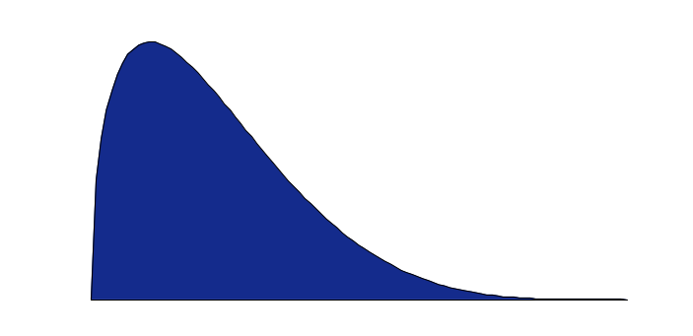
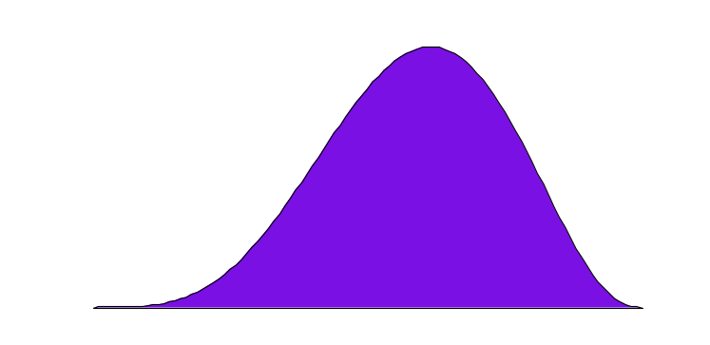
Overview
Usually, we do not know these distributions!
Tardiness
Worst Case Execution Time
Worst Case Response Time
Execution time
Response time
Hard-Real-Time Schedulable
Soft-Real-Time Schedulable
Deadline
Deadline

Slide 5

Disadvantages for Soft Real Time
Worst Case Execution Time
Worst case execution time may be much larger than average case, especially on multiprocessors.
Worst case execution time may be difficult to determine, especially on multiprocessors.
Result: significant wasted processing capacity and pessimism.
What if we know more about the execution time distribution?

Slide 6
Example: decode HD video frames
Periodic: every 41.7 ms
Average execution time: 14.5 ms
Worst case execution time: ?
  Observed worst case was large enough to require a dedicated processor (i.e., close to 41.7 ms).
  The true worst case can only be larger…
Strategies:
  Give up and assign a dedicated processor.
  Plug average execution time into worst case analysis and “hope it works.”
  Use a true average case analysis.
Using average case analysis, we can guarantee that a certain buffer size will be sufficient with high probability.

Slide 7
Related Work
Varying execution times or utilization, but worst-case utilization constrained:
  Abeni and Buttazzo [ECRTS 1999]
  Brandt et al. [RTSS 2003]
Implements constant bandwidth server but does not attempt average case analysis:
  Baruah et al. [RTAS 2002]
Average case analysis, worst-case utilization unconstrained, but tardiness bounds are on the order of WCET:
  Mills and Anderson [RTAS 2010]: GEDF only.

Slide 8
Main Contributions
Characterize workload by mean and variance of execution time.
  Experimental estimates of mean and variance are unbiased.
  Worst case execution times do not need to exist.
Schedule jobs on a multiprocessor using servers with budget enforcement.
Derive analytical bounds for average case response time and probabilistic deadlines.
  Supports a variety of scheduling algorithms.
  Separates the stochastic and deterministic analysis (allows plug-in of new deterministic analysis).

Slide 9
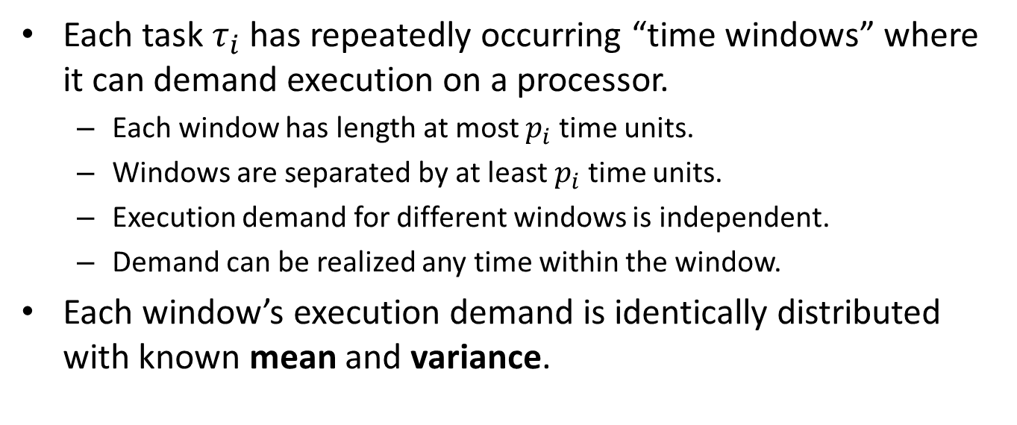
Task Model
Each task $τ_{i}$ has repeatedly occurring “time windows” where it can demand execution on a processor.
  Each window has length at most $p_{i}$ time units.
  Windows are separated by at least $p_{i}$ time units.
  Execution demand for different windows is independent.
  Demand can be realized any time within the window.
Each window’s execution demand is identically distributed with known mean and variance.
Example: the sporadic task model is a special case.
Each job = one window. All demand realized at beginning of window.
Mean execution demand = WCET. Variance = 0.

Slide 10
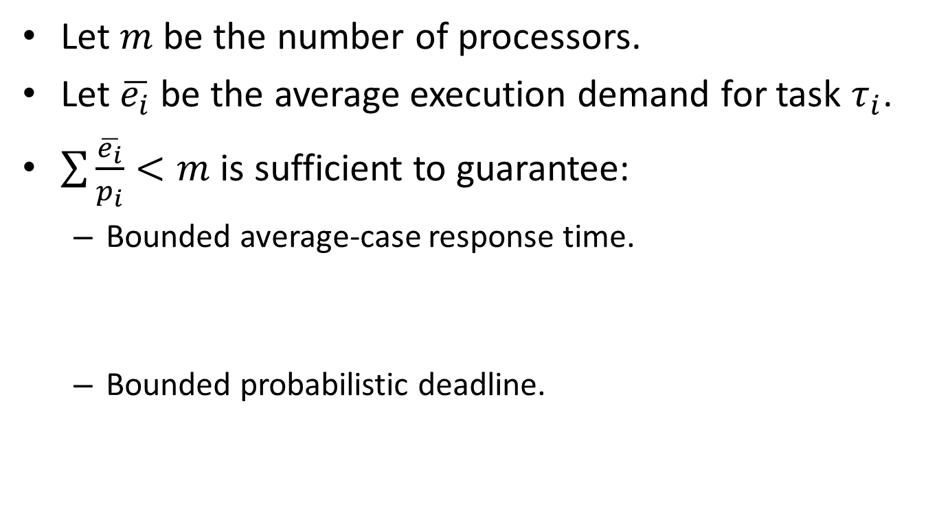
Constraints
Let $m$ be the number of processors.
Let $\overline{e_{i}}$ be the average execution demand for task $τ_{i}$.
$\sum{\frac{\overline{e_{i}}}{p_{i}}}<m$ is sufficient to guarantee:
  Bounded average-case response time.
  Bounded probabilistic deadline.
An upper bound on the average amount of time between job release time and job completion time.
Given a time, the probability that execution completes before that time.

Slide 11
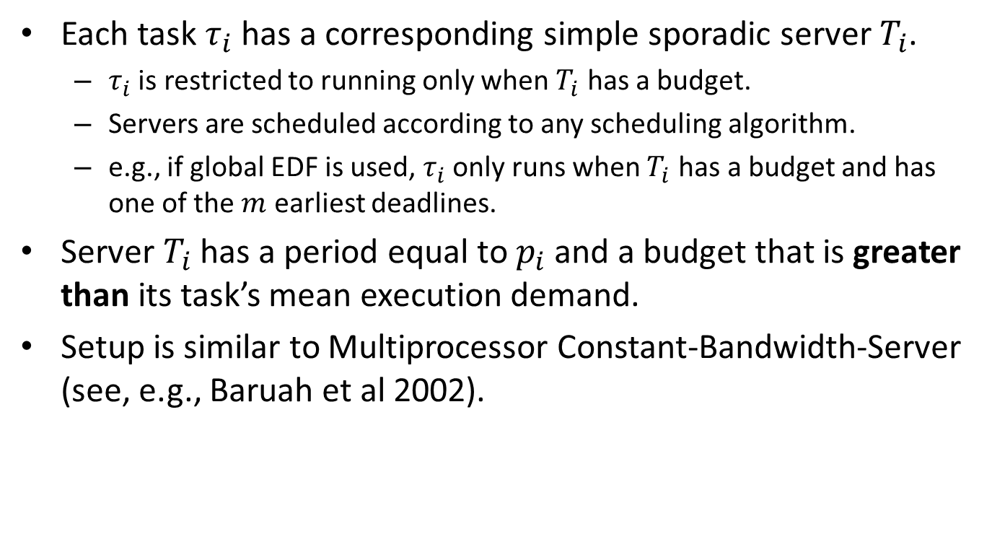
Server Execution
Each task $τ_{i}$ has a corresponding simple sporadic server $T_{i}$.
  $τ_{i}$ is restricted to running only when $T_{i}$ has a budget.
  Servers are scheduled according to any scheduling algorithm.
  e.g., if global EDF is used, $τ_{i}$ only runs when $T_{i}$ has a budget and has one of the $m$ earliest deadlines.
Server $T_{i}$ has a period equal to $p_{i}$ and a budget that is greater than its task’s mean execution demand.
Setup is similar to Multiprocessor Constant-Bandwidth-Server (see, e.g., Baruah et al 2002).

Slide 12
Analysis
Key point: budget enforcement ensures that long-running jobs of one task do not interfere with jobs of other tasks.
Two sources of increased response time for a job:
  Corresponding server was tardy.
  Job ran longer than its server’s budget due to randomness in execution times.
Average response time =
+
Deterministic part
Stochastic part
Deterministic part
Stochastic part
Known algorithmic tardiness bounds.
New analysis.

Slide 13
Analysis
Average response time =
+
Deterministic part depends on server budgets, which are on the order of mean execution time.
Stochastic part depends on mean and variance of execution times.
Average response time depends on execution time only through mean and variance.
Deterministic part
Stochastic part
Known algorithmic tardiness bounds.
New analysis.

Slide 14
Analysis
Average response time =
+
Our analysis does not need to be repeated for new scheduling algorithms or analysis.
Reduction in bound for certain special cases
(e.g., sporadic stochastic task with implicit deadline).
Deterministic part
Stochastic part
Known algorithmic tardiness bounds.
New analysis.

Slide 15
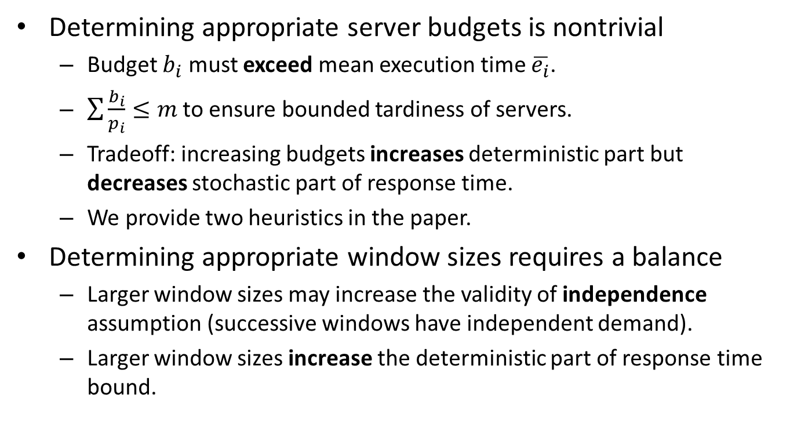
Challenges for Application
Determining appropriate server budgets is nontrivial
  Budget $b_{i}$ must exceed mean execution time $\overline{e_{i}}$.
  $\sum{\frac{b_{i}}{p_{i}}}≤m$ to ensure bounded tardiness of servers.
  Tradeoff: increasing budgets increases deterministic part but decreases stochastic part of response time.
  We provide two heuristics in the paper.
Determining appropriate window sizes requires a balance
  Larger window sizes may increase the validity of independence assumption (successive windows have independent demand).
  Larger window sizes increase the deterministic part of response time bound.

Slide 16
Conclusion
Type of system studied:
  Average-case utilization constrained.
  Mean and variance of execution demand are known.
  Worst case execution time need not be known.
Such a system is provably schedulable under the following timing guarantees:
  Average-case response time bound.
  Probabilistic deadline.
Significant flexibility in the analysis:
  Support for a variety of multiprocessor scheduling algorithms.
  Separation of deterministic and stochastic analysis allows for easy improvement.

Slide 17
Future Work
Members of the UNC Real-Time Group implemented the server based scheduler on LITMUS^{RT} as part of a case study.
Case study details:
  HD video decoding on 12 core multiprocessor system.
  HRT, Stochastic SRT, and Best Effort tasks.
  Restricted processor supply due to HRT tasks.
  Best Effort tasks require minimum throughput level.
Results in Kenna et al. [RTSS11, to appear].

Slide 18

Thank You
amills@unc.edu
Real-Time Systems Group at UNC
http://cs.unc.edu/~anderson/real-time/

