Slide 1
Processes in Linux
Jonathan Herman

Slide 2
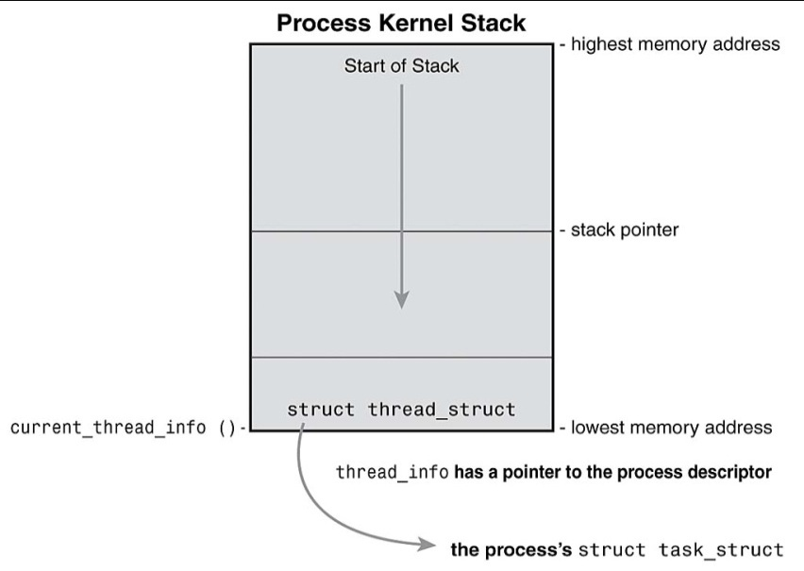
Representation
A task is synonymous with a process in Linux.
All tasks on the system are represented in a linked list of task_structs. These are a little over 1kb each.
When a process is being run, a thread_info struct is placed at the bottom of the process’s kernel stack, which points to the task_struct for the process itself.

Slide 3

Representation
The kernel maintains a task_struct for every task in the system. This struct holds all information about the task, including:
  Task State
  Process Stack and Heap
  Scheduling Information
  Signaling Information
  Identifiers
  CPU Context
  Resources
  Virtual Memory
Notes:
Scheduling info:
Policy (normal and real time)
Priority
rt_priority (priority for real time)
Counter (time process is allowed to run for, set for 'priority' when first run and decremented for each clock

Slide 4
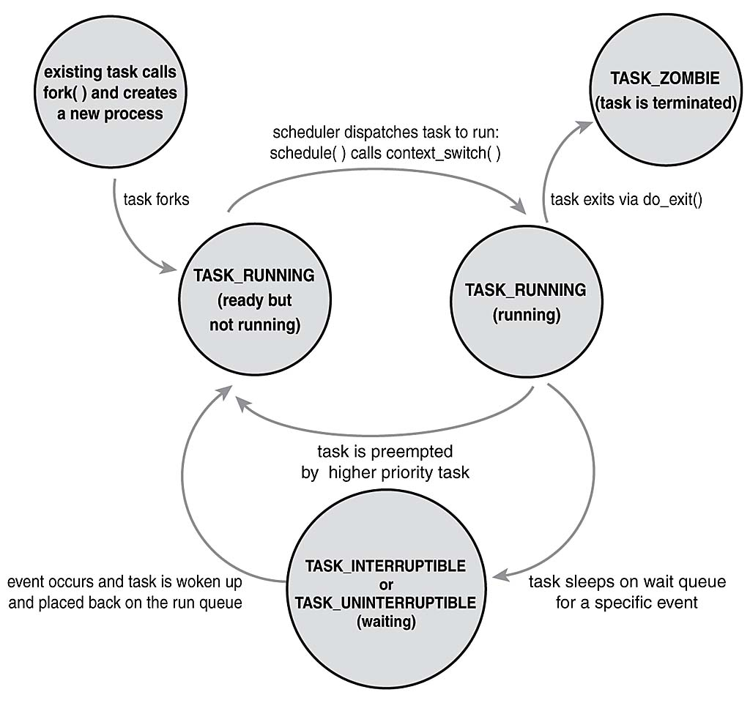
State

Slide 5
Signaling Information
The signals the task_struct handles are basic kernel signals like SIGKILL and SIGCONT.
The task_struct contains two 32 bit fields, sigpending and blocked, which store a bitmask of currently pending and blocked signals, respectively.
There is also a sighand_struct with an array of sigaction data structures for handling signals.

Slide 6
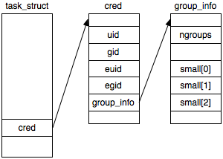
Identifiers
Each task_struct has a process ID, user ID, and a group ID .
The group and user IDs are used to control access to resources.
The IDs can change at runtime to give the process access to different resources.

Slide 7
CPU Context
All information about the state of the CPU is held in a task_struct’s thread_struct.
During a context switch, the entire CPU specific state of the task is saved in the thread_struct.
Each CPU architecture defines its own thread_struct definition as well as the methods needed to save and load state with thread_struct.

Slide 8
Resources
task_struct contains fs_struct contains information about how the process is using the fileystem.
Contains the current working directory, the root directory, and the default create / access mode for files.

Slide 9
Resources
task_struct also has files_struct with pointers to 256 file structures.
Because of UNIX’s ‘Everything is a file’ rule, this is effectively the list of resources in use.
Each has a descriptor, file access mode, position in the file for next read or write, and pointers to the Linux file operation routines.
All processes have at least 3 file structs: standard input, standard output, and standard error.

Slide 10
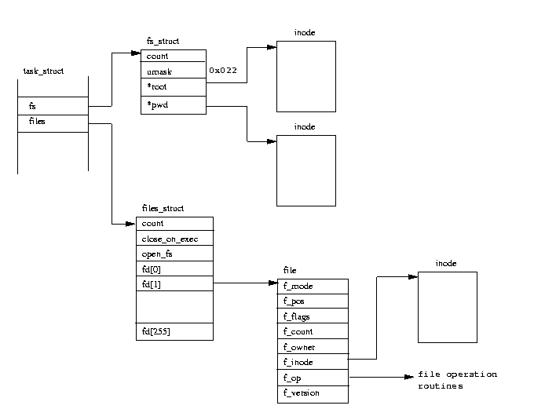
Resources

Slide 11
Virtual Memory
An mm_struct contains all information about the virtual memory used by the process.
Contains pointers to vm_area_structs, each representing an area of virtual memory.
Each vm_area_struct contains a pointer to operations for virtual memory routines.
Some vm_area_structs are merely pointers to shared function routines used by multiple processes.
The vm_area_struct can map to areas of memory not only loaded yet. It only cares about the virtual address space. The kernel takes care of the rest.

Slide 12
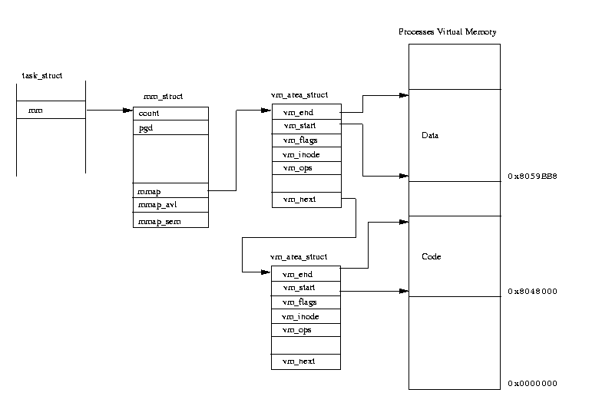
Virtual Memory

Slide 13
Creation
All processes are children of other processes, with the root process being init.
Processes are created by cloning the task_struct of the parent process. Only after the new task_struct is a complete copy of the parent is the new struct configured with the information of the new process.
After the struct has been built, exec(…) is called to load the executable binary into the struct’s address space.
Processes can share fs_structs, files_structs, and mm_structs e.g. multiple threads in a program.

Slide 14
Multi-Threading
When two threads are part of the same program, it just means there are two tasks operating in the same virtual address space.
The kernel itself is not aware of threads. They are just a way of sharing resources.
When tasks are cloned, you can specify the shared resources yourself, eg:
  clone(CLONE_VM | CLONE_FS | CLONE_FILES | CLONE_SIGHAND, 0);

